Slide 1

Node Microservices

Slide 2
BROWSER
SERVER
HTTP + URL
NAVIGATION
HTML PAGES
CSS
HTML + CSS
HTTP + URL
HTML + CSS
Page
Reload!

Slide 3
BROWSER
SERVER
HTTP + URL
NAVIGATION
HTML + CSS
Server PAGES
CSS
HTTP + URL
ASP
ASP .NET
JSP
PHP
Ruby
Express JS
HTML + CSS
Page
Reload!
DB

Slide 4
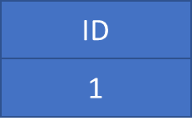
BROWSER
SERVER
HTTP + URL
NAVIGATION
Server PAGES
CSS
HTML + CSS + JS
AJAX - HTTP + URL
JS
Partial
Page
Reload!
PARTIAL HTML
<table>
<thead>
<tr>
<th>ID</th>
</tr>
</thead>
<tbody>
<tr>
<td>1</td>
</tr>
</tbody>
</table>
ASP
ASP.NET
JSP
PHP
Ruby
ASP .NET MVC
Spring MVC
Ruby On Rails
Laravel
DB

Slide 5
SINGLE PAGE APPLICATION – Cross Domain
Client Side Rendering (CSR)
SERVER
SERVER PAGES
CSS
BROWSER
HTTP + URL
NAVIGATION
JS
HTML + CSS + JS
ASP
ASP .NET
JSP
PHP
Ruby
ASP .NET MVC
Spring MVC
Ruby On Rails
Laravel
Express JS MVC
<table>
<thead>
<tr>
<th>ID</th>
</tr>
</thead>
<tbody>
<tr>
<td>1</td>
</tr>
</tbody>
</table>
SERVER
AJAX - HTTP + URL
RESTful API
ASP .NET Web API
JWS
Express JS
Python
DB
JSON to HTML on Client Side
JSON
{
“id”:1
}
Vanilla JS, jQuery, KO, BB, NG 1,
NG 2 and above, React JS, Vue JS

Slide 6
Installation
Install Node Latest LTS version - https://nodejs.org/en/
Install / Update Visual Studio Code to Latest Release - https://code.visualstudio.com/
Extensions of Visual Studio Code
AutoFileName
vscode-icons
JavaScript (ES6) code snippets
File Menu -> Preferences -> File Icon Theme -> Select VScode Icons

Slide 7
Babel
Babel is a JavaScript compiler.
Babel is a toolchain that is mainly used to convert ECMAScript 2015+ code into a backwards compatible version of JavaScript in current and older browsers or environments.
Here are the main things Babel can do for you:
Transform syntax
Polyfill features that are missing in your target environment (through a third-party polyfill such as core-js)
Source code transformations (codemods)

Slide 8
Commands
Create a new folder and run the following commands on the folder path:
npm init -y
npm i -D @babel/core @babel/preset-env @babel/cli
npm i core-js
Create a file named babel.config.json with preset configuration
To Compile
npx babel --version
npx babel src --out-dir output

Slide 9
Steps to run the application
Download and Extract the zip file.
Open the extracted folder in Visual Studio Code
Open the terminal window on the folder path and run
npm install
Once the installation completes, run
node output/main.js
Open HTML page in browser to see the output in console

Slide 10
Build Tools
Build Tools are utilities that help automate the transformation and bundling of your code into a single file. Most JavaScript projects use these build tools to automate the build process.
There are several common build tools available that can be integrated with Babel.
Some of the tools are:
Browserify
Grunt
Gulp
Webpack

Slide 11
Client Side Build
ES 2015 +
(Multiple Files)
Manual Configuration
Learn Node JS
Learn Webpack
Learn Babel & Config.
Learn Polyfill
Babel +
Preset (Env) +
Polyfill (core-js)
Build & Deploy your
Project on Local Server
Build your project
Browser Compatible Files
(Multiple Files)
WEBPACK-DEV-
SERVER
WEBPACK
CLI
Bundling
BROWSER
WEBPACK
Single File / Set of Files
Local
HTTP Server
HTML PAGE
Deploy
Inject

Slide 12
Webpack Configuration Steps
Entry Point
Mode
Extensions
Loaders (Used to pre-process files)
Plugins
Optimization
Output

Slide 13
Steps to run the application
Download and Extract the zip file.
Open the extracted folder in Visual Studio Code
Open the terminal window on the folder path and run
npm install
Once the installation completes, run
npm start – Starts the Development Server on localhost:3000
npm run build – To create a production build in dist folder
npm run build-serve – To create a production build in dist folder and serve it locally

Slide 14
Variables
Variables are containers for storing data (storing data values).
There are 4 Ways to Declare a JavaScript Variable:
Using var
Using let
Using const
Using nothing (Not Recommended)
Always declare JavaScript variables with var, let, or const.
The var keyword is used in all JavaScript code from 1995 to 2015.
The let and const keywords were added to JavaScript in 2015.
If you want your code to run in older browser, you must use var.

Slide 15
Datatypes
The set of types in the JavaScript language consists of primitive values and objects.
Primitive Values - Immutable datum represented directly at the lowest level of the language
Null – null
Undefined – undefined
Boolean() – boolean
Number() – number
String() – string
Symbol (ECMAScript 2015) – symbol – We cannot use new keyword with Symbol()
Objects - An object is a mutable value in memory which is possibly referenced by an identifier.
Object() - object

Slide 16
Mutable vs Immutable
JavaScript Engine handles mutable and immutable objects differently.
Immutable are quicker to access than mutable objects.
Mutable objects are great to use when you need to change the size of the object, example array, set etc..
Immutable are used when you need to ensure that the object you made will always stay the same.
Immutable objects are fundamentally expensive to “change”, because doing so involves creating a copy.
Changing mutable objects is cheap.

Slide 17
JavaScript types
All types except objects define immutable values (that is, values which can't be changed)
Boolean type: Boolean represents a logical entity and can have two values: true and false. See Boolean and Boolean for more details.
Null type: The Null type has exactly one value: null. See null and Null for more details.
Undefined type: A variable that has not been assigned a value has the value undefined. See undefined and Undefined for more details.
Number type: The Number type is a double-precision 64-bit binary format value (numbers between -(2^53 − 1) and 2^53 − 1). In addition to representing floating-point numbers, the number type has three symbolic values: +Infinity, -Infinity, and NaN ("Not a Number").
String type: JavaScript's String type is used to represent textual data. It is a set of "elements" of 16-bit unsigned integer values. Each element in the String occupies a position in the String.
Symbol type: A Symbol is a unique and immutable primitive value and may be used as the key to an Object property.
Objects: An object is a value in memory which is possibly referenced by an identifier. objects can be seen as a collection of properties. Properties are identified using key values. A key value is either a String value or a Symbol value.

Slide 18
Standard built-in objects
Value properties
Infinity
NaN
undefined
globalThis
Function properties
eval()
uneval()
isFinite()
isNaN()
parseFloat()
parseInt()
encodeURI()
encodeURIComponent()
decodeURI()
decodeURIComponent()
Fundamental objects
Object
Function
Boolean
Symbol
Error objects
Error
AggregateError
EvalError
InternalError
RangeError
ReferenceError
SyntaxError
TypeError
URIError

Slide 19
Standard built-in objects
Numbers and dates
Number
Math
Date
Text processing
String
RegExp
Indexed collections
Array
Int8Array
Uint8Array
Uint8ClampedArray
Int16Array
Uint16Array
Int32Array
Uint32Array
Float32Array
Float64Array

Slide 20
Standard built-in objects
Keyed collections
Map
Set
WeakMap
WeakSet
Structured data
ArrayBuffer
DataView
JSON
Control abstraction objects
Promise
Generator
GeneratorFunction
AsyncFunction
AsyncGenerator
AsyncGeneratorFunction
Reflection
Reflect
Proxy

Slide 21
Statements & Loops
Control Flow
Block { }
break
continue
Empty
if…else
switch
throw
try…catch
Iterations
for
for...in
for…of
while
do…while

Slide 22
Functions
Functions are one of the fundamental building blocks in JavaScript.
A function in JavaScript is like a procedure—a set of statements that performs a task or calculates a value, but for a procedure to qualify as a function, it should take some input and return an output.
To use a function, you must define it somewhere in the scope from which you wish to call it.
In JavaScript, functions are first-class objects, because they can have properties and methods just like any other object.
What distinguishes them from other objects is that functions can be called.
Every JavaScript function is a Function object.

Slide 23
Functions
function
Declares a function with the specified parameters.
function*
Generator Functions, enable writing iterators more easily
async function
Declares an async function with the specified parameters.

Slide 24
Function Parameters & Arguments
Function Parameters are the names that are define in the function definition and real values passed to the function in function definition are known as arguments.
Parameter Rules:
There is no need to specify the data type for parameters in JavaScript function definitions.
It does not perform type checking based on passed in JavaScript function.
It does not check the number of received arguments.
If a function is called with missing arguments (less than declared), the missing values are set to undefined.

Slide 25
The Arguments Object
JavaScript functions have a built-in object called the arguments object.
The argument object contains an array of the arguments used when the function was called (invoked).
If a function is called with too many arguments (more than declared), these arguments can be reached using the arguments object.

Slide 26
Rest & Spread
The rest operator (…) allows us to call a function with any number of arguments and then access those excess arguments as an array. The rest operator also allows us in destructuring array or objects.
The spread operator (…) allows us to expand an iterable like array into its individual elements.

Slide 27
Pure and Impure Functions
A side-effect is any operation your function performs that is not related to computing the final output, including but not limited to:
Modifying a global variable
Modifying an argument
Making HTTP requests
DOM manipulation
Reading/writing files
A pure function must both be predictable and without side-effects. If either of these criteria is not met, we're dealing with an impure function.
A pure function, returns same result if same arguments are passed in, no matter how many times it runs.
An impure function, may return different result if same arguments are passed in, on multiple runs

Slide 28
IIFE
Immediately Invoked Function Expression (IIFE) is one of the most popular design patterns in JavaScript.
It is pronounced as, iify.
As name suggest, IIFE is a function expression that automatically invokes after completion of the definition.
IEFE solves this problem by having its own scope and restricting functions and variables to become global.
The functions and variables declare inside IIFE will not pollute global scope even they have same name as global variables & functions.

Slide 29
Function Overloading
JavaScript does not support function overloading.
If we create two function with same name, the second function will overwrite the first function.
To handle same function names in JavaScript
The first recommendation is to use a different and self-explanatory name for functions.
Using default values for the parameters.
Checking the number of arguments and type of arguments.
Passing the last parameter to describe the kind of option the function should perform. We can use switch or if...else to perform the required operation.

Slide 30
Callback
A callback is a function that is passed as an argument to another function, which is expected to invoke it either immediately or at some point in the future.
Callbacks can be seen as a form of the continuation-passing style (CPS), in which control is passed explicitly in the form of a continuation; in this case the callback passed as an argument represents a continuation.
There are two types of callbacks.
A callback passed to a function can be invoked synchronously before return
Or it can be deferred to execute asynchronously some time after return.

Slide 31
Function Currying
Currying is a way of constructing functions that allows partial application of a function’s arguments.
What this means is that you can pass all the arguments a function is expecting and get the result or pass a subset of those arguments and get a function back that’s waiting for the rest of the arguments.

Slide 32
Closure
A closure is a function or reference to a function together with a referencing environment — a table storing a reference to each of the non-local variables of that function.
Closures are functions that refer to independent (free) variables. In other words, the function defined in the closure 'remembers' the environment in which it was created.
A closure is a special kind of object that combines two things: a function, and the environment in which that function was created. The environment consists of any local variables that were in-scope at the time that the closure was created.

Slide 33
JavaScript ‘this’ keyword
In JavaScript, “context” refers to an object.
Within an object, the keyword “this” refers to that object, and provides an interface to the properties and methods that are members of that object.
When a function is executed, the keyword “this” refers to the object that the function is executed in.
Scenarios
When a function executes in the global context, “this” refers to the global, or “window” object
When a function is a method of an Object, “this” refers to that object (unless it is manually executed in the context of a different object)
When a function executes inside of another function (no matter how deeply nested), “this” refers to the object whose context within which it is executed
When you instantiate a constructor function, inside of the instance object, “this” refers to the instance object

Slide 34
Higher Order Functions
Functions that operate on other functions, by taking them as arguments and by returning them, are called higher-order functions.
Higher-order functions allow us to abstract over actions, not just values.

Slide 35
JSON
JSON is a format for storing and transporting data.
JSON is often used when data is sent from a server to a web page.
What is JSON?
JSON stands for JavaScript Object Notation
JSON is a lightweight data interchange format
JSON is language independent *
JSON is "self-describing" and easy to understand
The JSON syntax is derived from JavaScript object notation syntax, but the JSON format is text only.
Code for reading and generating JSON data can be written in any programming language.

Slide 36
Objects
A JavaScript object is an entity having state and behavior (properties and method). For example: car, pen, bike, chair, glass, keyboard, monitor etc.
JavaScript is an object-based language. Everything is an object in JavaScript.
We can create objects directly.
By object literal
By creating instance of Object directly (using new keyword)
By using an object constructor (using new keyword)

Slide 37
toy1
__proto__
Object.prototype
constructor
hasOwnProperty()
toString()
.

Slide 38
toy1
Object.prototype
Color = “red”
Shape = “square”
toy1.color
toy2
toy2.color

Slide 39
var s = “Hi”
s = “Hello”
s
Hi
Hello

Slide 40
toy1
color
shape
__proto__
Object.prototype
constructor
hasOwnProperty()
toString()
.
toy2
color
shape
__proto__

Slide 41
toy1
__proto__
Object.prototype
constructor
hasOwnProperty()
toString()
color=“red”
shape=“circle”
.
toy2
__proto__
toy1
__proto__
Object.prototype
constructor
hasOwnProperty()
toString()
color=“red”
shape=“circle”
.
toy2.color = “blue”;
toy2.shape = “square”
toy2
color
shape
__proto__

Slide 42
v.start()
Vehicle.prototype
start()
__proto__
Object.prototype
constructor
hasOwnProperty()
toString()
.
.
v
__proto__
FourWheeler.prototype
__proto__
Object.prototype
constructor
hasOwnProperty()
toString()
.
.
v.start() - Error
v
__proto__

Slide 43
FourWheeler.prototype
move()
__proto__
Vehicle.prototype
start()
__proto__
Object.prototype
constructor
hasOwnProperty()
toString()
.
.
v
__proto__
FourWheeler.prototype
start()
move()
__proto__
Vehicle.prototype
start()
__proto__
Object.prototype
constructor
hasOwnProperty()
toString()
.
.
v
__proto__

Slide 44
Indexed collections
Array
Int8Array
Uint8Array
Uint8ClampedArray
Int16Array
Uint16Array
Int32Array
Uint32Array
Float32Array
Float64Array

Slide 45
Arrays
Arrays are an ordered collection that can hold data of any type. In JavaScript, arrays are created with square brackets [...] or using Array constructor and allow duplicate elements.
JavaScript objects and arrays were the most important data structures to handle collections of data.
The combination of objects and arrays was able to handle data in many scenarios, however, there were a few shortcomings as follows
Object keys can only be of type string.
Objects don't maintain the order of the elements inserted into them.
Objects lack some useful methods, which makes them difficult to use in some situations. For example, you can't compute the size (length) of an object easily. Also, enumerating an object is not that straightforward.
Arrays are collections of elements that allow duplicates. Supporting arrays that only have distinct elements requires extra logic and code.

Slide 46
Keyed collections
Map
Set
WeakMap
WeakSet

Slide 47
Map
Map is a collection of key-value pairs where the key can be of any type. Map remembers the original order in which the elements were added to it, which means data can be retrieved in the same order it was inserted in.
In other words, Map has characteristics of both Object and Array:
Like an object, it supports the key-value pair structure.
Like an array, it remembers the insertion order.
A new Map can be created using Map Constructor.
Use Map when:
You may want to create keys that are non-strings. Storing an object as a key is a very powerful approach. Map gives you this ability by default.
You need a data structure where elements can be ordered. Regular objects do not maintain the order of their entries.
You are looking for flexibility without relying on an external library like lodash.

Slide 48
Set
A Set is a collection of unique elements that can be of any type.
Set is also an ordered collection of elements, which means that elements will be retrieved in the same order that they were inserted in.
A Set in JavaScript behaves the same way as a mathematical set.
Use Set when
You need to maintain a distinct set of data to perform set operations like union, intersection, difference, and so on.

Slide 49
Weak Map
The WeakMap object is a collection of key/value pairs in which the keys are objects only and the values can be arbitrary values.
The object references in the keys are held weakly, meaning that they are a target of garbage collection (GC) if there is no other reference to the object anymore.
One difference to Map objects is that WeakMap keys are not enumerable.
One use case of WeakMap objects is to store private data for an object, or to hide implementation details.

Slide 50
Weak Set
WeakSet objects are collections of objects.
An object in the WeakSet may only occur once.
It is unique in the WeakSet's collection, and objects are not enumerable.
The main differences to the Set object are:
In contrast to Sets, WeakSets are collections of objects only, and not of arbitrary values of any type.
The WeakSet is weak: References to objects in the collection are held weakly. If there is no other reference to an object stored in the WeakSet, they can be garbage collected. That also means that there is no list of current objects stored in the collection.
WeakSets are not enumerable.
The use cases of WeakSet objects are limited.
They will not leak memory, so it can be safe to use DOM elements as a key and mark them for tracking purposes.

Slide 51
Well-Known symbols
A list of symbols that JavaScript treats specially is published as well-known symbols.
Well-known symbols are used by built-in JavaScript algorithms. For example Symbol.iterator (@@iterator) is utilized to iterate over items in arrays, strings, or even to define your own iterator function.

Slide 52
Well-known symbol
Specification Name | [[Description]] | Value and Purpose
@@hasInstance | "Symbol.hasInstance" | A method that determines if a constructor object recognizes an object as one of the constructor’s instances. Called by the semantics of the instanceof operator.
@@isConcatSpreadable | "Symbol.isConcatSpreadable" | A Boolean valued property that if true indicates that an object should be flattened to its array elements by Array.prototype.concat.
@@iterator | "Symbol.iterator" | A method that returns the default Iterator for an object. Called by the semantics of the for-of statement.
@@match | "Symbol.match" | A regular expression method that matches the regular expression against a string. Called by the String.prototype.match method.
@@replace | "Symbol.replace" | A regular expression method that replaces matched substrings of a string. Called by the String.prototype.replace method.
@@search | "Symbol.search" | A regular expression method that returns the index within a string that matches the regular expression. Called by the String.prototype.search method.
@@species | "Symbol.species" | A function valued property that is the constructor function that is used to create derived objects.
@@split | "Symbol.split" | A regular expression method that splits a string at the indices that match the regular expression. Called by the String.prototype.split method.
@@toPrimitive | "Symbol.toPrimitive" | A method that converts an object to a corresponding primitive value. Called by the ToPrimitive abstract operation.
@@toStringTag | "Symbol.toStringTag" | A String valued property that is used in the creation of the default string description of an object. Accessed by the built-in method Object.prototype.toString.
@@unscopables | "Symbol.unscopables" | An object valued property whose own property names are property names that are excluded from the with environment bindings of the associated object.

Slide 53
Iterators & Generators
Iterators and Generators bring the concept of iteration directly into the core language and provide a mechanism for customizing the behavior of for...of loops.
In JavaScript an iterator is an object which defines a sequence and potentially a return value upon its termination.
Specifically, an iterator is any object which implements the Iterator protocol by having a next() method that returns an object with two properties:
value
The next value in the iteration sequence.
done
This is true if the last value in the sequence has already been consumed. If value is present alongside done, it is the iterator's return value.
Once created, an iterator object can be iterated explicitly by repeatedly calling next().

Slide 54
Generators
In JavaScript, generators provide a new way to work with functions and iterators. Generators provide an easier way to implement iterators.
Using a generator,
you can stop the execution of a function from anywhere inside the function
and continue executing code from a halted position
To create a generator, you need to first define a generator function with function* symbol.
You can pause the execution of a generator function without executing the whole function body by using yield keyword.
The yield expression returns a value. However, unlike the return statement, it doesn't terminate the program. That's why you can continue executing code from the last yielded position.

Slide 55
Generator Methods
Method | Description
next() | Returns a value of yield
return() | Returns a value and terminates the generator
throw() | Throws an error and terminates the generator

Slide 56
Uses of Generators
Generators let us write cleaner code while writing asynchronous tasks.
Generators provide an easier way to implement iterators.
Generators execute its code only when required.
Generators are memory efficient.

Slide 57
Modules
As our application grows bigger, we want to split it into multiple files, so called “modules”.
Until ES6, JavaScript existed without a language-level module syntax.
JavaScript community invented a variety of ways to organize code into modules, special libraries to load modules on demand.
AMD – one of the most ancient module systems, initially implemented by the library require.js.
CommonJS – the module system created for Node.js server.
UMD – one more module system, suggested as a universal one, compatible with AMD and CommonJS.
The language-level module system appeared in the standard in ECMASCRIPT 2015

Slide 58
Modules
A module is just a file. One script is one module. As simple as that.
A module may contain a class or a library of functions for a specific purpose.
Modules can load each other and use special directives export and import to interchange functionality, call functions of one module from another one:
export keyword labels variables and functions that should be accessible from outside the current module.
import allows the import of functionality from other modules.

Slide 59
Promise vs Callbacks
There are several advantages of using a promise over a callback in JavaScript. Here are some of the advantages of using a promise:
They are composable, unlike callbacks, therefore we can avoid callback hells
You can easily execute code with Promise.all when multiple responses are returned
You can wait for only one result from concurrent pending promises with the help of Promise.race
You can write asynchronous code in a synchronous manner if you use it in conjunction with async / await.
While they are a perfect choice over callbacks, there are some minor disadvantages we need to cover as well. Here are some:
They can only operate on a single value at a time
They are not available in older browser; they must be polyfilled

Slide 60
Promise Guarantees
Unlike old-fashioned passed-in callbacks, a promise comes with some guarantees:
Callbacks added with then() will never be invoked before the completion of the current run of the JavaScript event loop.
These callbacks will be invoked even if they were added after the success or failure of the asynchronous operation that the promise represents.
Multiple callbacks may be added by calling then() several times. They will be invoked one after another, in the order in which they were inserted.
One of the great things about using promises is chaining.
A common need is to execute two or more asynchronous operations back-to-back, where each subsequent operation starts when the previous operation succeeds, with the result from the previous step. We accomplish this by creating a promise chain.

Slide 61
Fetch API
The Fetch API provides a JavaScript interface for accessing and manipulating parts of the HTTP pipeline, such as requests and responses.
It also provides a global fetch() method that provides an easy, logical way to fetch resources asynchronously across the network.
This kind of functionality was previously achieved using XMLHttpRequest.
Fetch provides a better alternative that can be easily used by other technologies such as Service Workers.
Fetch also provides a single logical place to define other HTTP-related concepts such as CORS and extensions to HTTP.

Slide 62
Node JS

Slide 63
What is Node.js?
Node.js® is a JavaScript runtime built on Chrome's V8 JavaScript engine.
As an asynchronous event-driven JavaScript runtime
Node.js is designed to build scalable network applications.

Slide 64
What is Node.js?
Node.js is
open-source
cross-platform
back-end JavaScript runtime environment
runs on the V8 engine
executes JavaScript code outside a web browser.
Node.js lets developers use JavaScript for server-side scripting.
Node.js represents a "JavaScript everywhere" paradigm
Unifying web-application development around a single programming language.

Slide 65
Installation
Install Node LTS version - https://nodejs.org/en/
Install / Update Visual Studio Code to Latest Release - https://code.visualstudio.com/
Extensions of VS Code
AutoFileName
vscode-icons
JavaScript (ES6) code snippets
Node.js Modules Intellisense
After all Extensions are installed
File Menu -> Preferences -> File Icon Theme -> Select VScode Icons

Slide 66
Node Global Objects
Node.js Global Objects are those objects which are present in all modules.
Global Objects can be used directly in the application which is available without importing any module.
Global objects have been added keeping in mind that these are some basic requirements and one can require these anytime, so it is better to keep them global rather than to add specific modules for these objects.
Some of the Node.js Global Objects:
Buffer Class
console
process
setImmediate
setTimeout

Slide 67
NODE EXE (NODE PROCESS)
node app.js
V8 Engine
Node JS API’s
Application
(JavaScript)
app.js
NATIVE CODE
O. S.

Slide 68
NODE APIs
V8 Engine
API’s
Libuv
(Asynchronous I/O)
Developer Uses the NODE API’s in JavaScript Language

Slide 69
Working of Node.js
Node.js runs on chrome v8 engine which converts JavaScript code into machine code, it is highly scalable, lightweight, fast, and data-intensive.
To operate I/O operations or requests node.js use the concept of threads. Thread is a sequence of instructions that the server needs to perform.
Node.js is an event loop single-threaded language.
Node.js basically works on two concept
Asynchronous
Non-blocking I/O (Libuv)

Slide 70
Non-blocking I/o
Non-blocking i/o means working with multiple requests without blocking the thread for a single request.
I/O basically interacts with external systems such as files, databases.
Node.js is not used for CPU-intensive work means for calculations, video processing because a single thread cannot handle the CPU works.

Slide 71
Asynchronous
Asynchronous is executing a callback function.
The moment we get the response from the other server or database it will execute a callback function.
Callback functions are called as soon as some work is finished and this is because the node.js uses an event-driven architecture.
The single thread doesn’t work with the request instead it sends the request to another system which resolves the request and it is accessible for another request.

Slide 72
Libuv
To implement the concept of the system to handle the request node.js uses the concept of Libuv.
Libuv is an open-source library built-in C. It has a strong focus on asynchronous and I/O, this gives node access to the underlying computer operating system, file system, and networking.
Libuv implements two extremely important features of node.js
Event loop
Thread pool

Slide 73
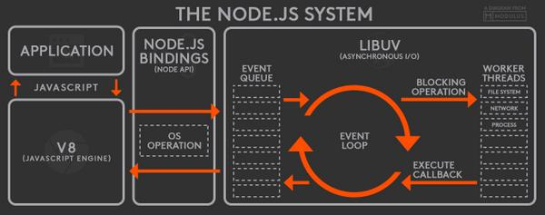

Slide 74
Event Loop
The event loop contains a single thread and is responsible for handling easy tasks like executing callbacks and network I/O.
All the applications code that is inside callback functions will run in the event loop.
EventLoop is the heart of node.js. When we start our node application the event loop starts running right away. Most of the work is done in the event loop.
Nodejs use event-driven-architecture.
Events are emitted.
Event loop picks them up.
Callbacks are called.

Slide 75
Event Queue
As soon as the request is sent the thread places the request into a queue. It is known as an event queue.
The process like app receiving HTTP request or server or a timer will emit event as soon as they are done with the work and event loop will pick up these events and call the callback functions that are associated with each event and response is sent to the client.
The event loop is an indefinite loop that continuously receives the request and processes them.
It checks the queue and waits for the incoming request indefinitely.

Slide 76
Thread Pool
Though node.js is single-threaded it internally maintains a thread pool.
When non-blocking requests are accepted there are processed in an event loop
While accepting blocking requests Node JS
Checks for available threads in a thread pool
Assigns a thread to the client’s request which is then processed and send back to the event loop
Response is sent to the respective client.

Slide 77
Modules
Module in Node.js is a simple or complex functionality organized in single or multiple JavaScript files which can be reused throughout the Node.js application.
Each module in Node.js has its own context, so it cannot interfere with other modules or pollute global scope. Also, each module can be placed in a separate .js file under a separate folder.
Node.js implements CommonJS modules standard.
CommonJS is a group of volunteers who define JavaScript standards for web server, desktop, and console application.

Slide 78
Types of Modules
Core Modules (Built-in Modules)
Global Modules (Objects)
Local Modules (User Defined Modules)
External Modules (Third Party Modules)

Slide 79
require(Path)
Module Loader will search for a file on the path specified
Y
N
Load and cache the file on the memory
Module Loader will search for a folder on the path specified
Y
N
Search inside folder, file with the name ‘package.json’
Error Loading Module
Y
N
N
In ‘package.json’, read ‘main’ key
Search inside folder, file with the name ‘index.js’
N
Y
Y
Search file mentioned in ‘main’
N
Load and cache the file on the memory
Y
Load and cache the file on the memory
NODE JS Module Resolution

Slide 80
Built-in Modules / Core Modules
Built-in modules of node.js that are part of NodeJS and come with the Node.js installation process are known as core modules.
To load/include this module in our program, we use the require() function.
The return type of require() function depends on what the particular module returns.

Slide 81
Built In Modules
Module | Description
assert | Provides a set of assertion tests
buffer | To handle binary data
child_process | To run a child process
cluster | To split a single Node process into multiple processes
crypto | To handle OpenSSL cryptographic functions
dgram | Provides implementation of UDP datagram sockets
dns | To do DNS lookups and name resolution functions
events | To create and handle events
fs | To handle the file system
http | To make Node.js act as an HTTP server
https | To make Node.js act as an HTTPS server.

Slide 82
Built In Modules Continued
Module | Description
net | To create servers and clients
os | Provides information about the operation system
path | To handle file paths
querystring | To handle URL query strings
readline | To handle readable streams one line at the time
stream | To handle streaming data
string_decoder | To decode buffer objects into strings
timers | To execute a function after a given number of milliseconds
tls | To implement TLS and SSL protocols
tty | Provides classes used by a text terminal
url | To parse URL strings

Slide 83
Built In Modules Continued
Module | Description
util | To access utility functions
v8 | To access information about V8 (the JavaScript engine)
vm | To compile JavaScript code in a virtual machine
zlib | To compress or decompress files

Slide 84
N
Module Loader will search inside node_modules folder of your application
N
require(ModuleName)
Module Loader will search in built-in modules
Y
Module Loader will search for a file inside node_modules
Error Loading Module
Load the module on the memory
Y
N
Load and cache the file on the memory
Module Loader will search for a folder inside node_modules
Y
N
Search inside folder, file with the name ‘package.json’
Error Loading Module
Y
N
N
In ‘package.json’, read ‘main’ key
Search inside folder, file with the name ‘index.js’
N
Y
Y
Search file mentioned in ‘main’
N
Load and cache the file on the memory
Y
Load and cache the file on the memory
NODE JS Module Resolution

Slide 85
Readline Module
The readline module provides an interface for reading data from a Readable stream (such as process.stdin) one line at a time.

Slide 86
fs Module
With Node.js, you can programmatically manipulate files with the built-in fs module.
The name is short for “file system,” and the module contains all the functions you need to read, write, and delete files on the local machine.
This unique aspect of Node.js makes JavaScript a useful language for back-end and CLI tool programming.
The fs module supports interacting with files synchronously, asynchronously, or via streams;

Slide 87
fs Module Methods
fs.access(): check if the file exists and Node.js can access it with its permissions
fs.appendFile(): append data to a file. If the file does not exist, it's created
fs.chmod(): change the permissions of a file specified by the filename passed. Related: fs.lchmod(), fs.fchmod()
fs.chown(): change the owner and group of a file specified by the filename passed. Related: fs.fchown(), fs.lchown()
fs.close(): close a file descriptor
fs.copyFile(): copies a file
fs.createReadStream(): create a readable file stream
fs.createWriteStream(): create a writable file stream
fs.link(): create a new hard link to a file
fs.mkdir(): create a new folder

Slide 88
fs Module Methods
fs.mkdtemp(): create a temporary directory
fs.open(): set the file mode
fs.readdir(): read the contents of a directory
fs.readFile(): read the content of a file. Related: fs.read()
fs.readlink(): read the value of a symbolic link
fs.realpath(): resolve relative file path pointers (., ..) to the full path
fs.rename(): rename a file or folder
fs.rmdir(): remove a folder
fs.stat(): returns the status of the file identified by the filename passed. Related: fs.fstat(), fs.lstat()
fs.symlink(): create a new symbolic link to a file

Slide 89
fs Module Methods
fs.truncate(): truncate to the specified length the file identified by the filename passed. Related: fs.ftruncate()
fs.unlink(): remove a file or a symbolic link
fs.unwatchFile(): stop watching for changes on a file
fs.utimes(): change the timestamp of the file identified by the filename passed. Related: fs.futimes()
fs.watchFile(): start watching for changes on a file. Related: fs.watch()
fs.writeFile(): write data to a file. Related: fs.write()

Slide 90
What is Event-driven?
Event-driven architectures build on a common pattern in software development known as publish-subscribe or observer pattern.
In an event-driven architecture there are at least two actors: the subject and the observer.
Is JavaScript language Event Driven?
No
Can we create custom events in JavaScript?
No
If you want to create custom events, we can use
document.createEvent() – HTML Programming
Event Emitter – Node JS

Slide 91
Events
Node.js core API is built around an idiomatic asynchronous event-driven architecture in which objects called "emitters" emit named events that cause Function objects "listeners" to be called.
All objects that emit events are instances of the EventEmitter class.
These objects expose an eventEmitter.on() function that allows one or more functions to be attached to named events.
When the EventEmitter object emits an event, all the functions attached to that specific event are called synchronously.

Slide 92
Streams
A stream is an abstract interface for working with streaming data in Node.js.
Streams are one of the fundamental concepts of Node.js.
Streams are a type of data-handling methods and are used to read or write input into output sequentially.
Streams are used to handle reading/writing files or exchanging information in an efficient way.

Slide 93
ReadStream
HTTP responses, on the client
HTTP requests, on the server
fs read streams
zlib streams
crypto streams
TCP sockets
Child process stdout and stderr
process.stdin

Slide 94
WriteStream
HTTP requests, on the client
HTTP responses, on the server
fs read streams
zlib streams
crypto streams
TCP sockets
Child process stdin
process.stdout and stderr

Slide 95
BankAccount Class
withdraw(amount)
deposit(amount)
Create BankAccount class with withdraw, deposit and other methods if needed.
Withdraw should show error if amount to be withdrawn is greater than balance
in account
Show message after withdraw and deposit call, showing current balance
Send a SMS after withdraw or deposit is called
Send an Email after withdraw or deposit is called
Follow SOLID principal’s of writing code
SMS Class
send(msg)
EMAIL Class
send(msg)
WhatsApp Class
send(msg)

Slide 96
What is npm?
npm is the world's largest Software Registry.
The registry contains over 800,000 code packages.
Open-source developers use npm to share software.
Many organizations also use npm to manage private development.
You can download all npm public software packages without any registration or logon.
npm consists of three distinct components:
the website: Use the website to discover packages, set up profiles, and manage other aspects of your npm experience.
the Command Line Interface (CLI): The CLI runs from a terminal, and is how most developers interact with npm
the registry: The registry is a large public database of JavaScript software and the meta-information surrounding it.

Slide 97
npm cli
Local Installation
Production Packages
npm install --save <package_name>
npm install <package_name>
npm i <package_name>
Development Packages
npm install --save-dev <package_name>
npm install --dev <package_name>
npm i -D <package_name>
Local Un-installation
Production Packages
npm uninstall --save <package_name>
npm un <package_name>
Developement Packages
npm uninstall --save-dev <package_name>
npm un -D <package_name>

Slide 98
Steps to run the application
Download and Extract the zip file.
Open the extracted folder in Visual Studio Code
Open the terminal window on the folder path and run
npm install
OR
npm i
After the installation completes, run
node app.js

Slide 99
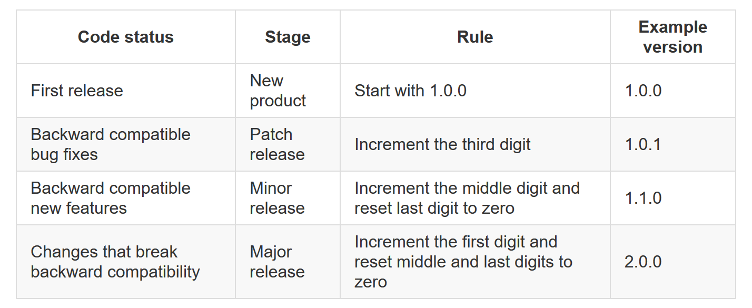

Slide 100
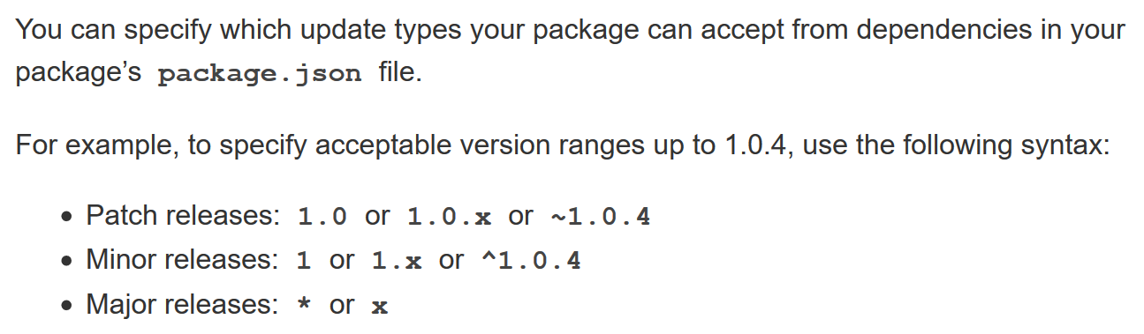

Slide 101
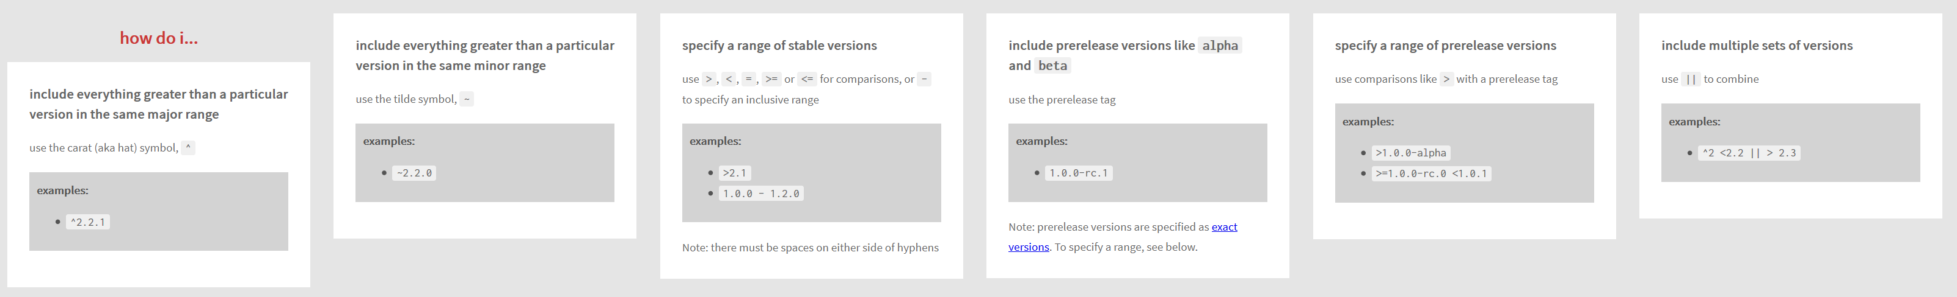

Slide 102
npm cli
Global Installation
npm install -g <package_name>
npm i -g <package_name>
Global Un-installation
npm uninstall -g <package_name>
npm un -g <package_name>
List all Global Packages installed
npm list -g --depth=0

Slide 103
Update Package Versions
npm-check-updates - npm (npmjs.com)

Slide 104
WebSocket
WebSocket is a computer communications protocol, providing full-duplex communication channels over a single TCP connection.
The WebSocket protocol was standardized by the IETF as RFC 6455 in 2011
The WebSocket API in Web IDL is being standardized by the W3C.
WebSocket uses HTTP as the initial transport mechanism but keeps the TCP connection alive after the HTTP response is received so that it can be used for sending messages between client and server.

Slide 105
NODE SERVER
BROWSER
HTTP + URL
HTML + JS
I want WebSocket Communication (WS Request)
Should have a code to accept and acknowledge the WebSocket Request
WebSocket Handshake
Acknowledgement

Slide 106
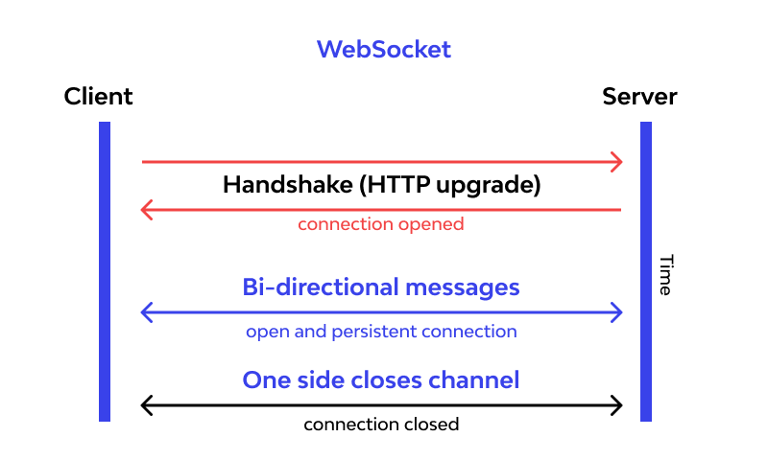

Slide 107
Express JS
Fast, unopinionated, minimalist web framework for Node.js
Express is a minimal and flexible Node.js web application framework that provides a robust set of features for web and mobile applications.
With a myriad of HTTP utility methods and middleware at your disposal, creating a robust API is quick and easy.

Slide 108
Express JS
Fast, unopinionated, minimalist web framework for Node.js
Express is a minimal and flexible Node.js web application framework that provides a robust set of features for web and mobile applications.
With a myriad of HTTP utility methods and middleware at your disposal, creating a robust API is quick and easy.

Slide 109
Template Engines
A template engine enables you to use static template files in your application.
At runtime, the template engine replaces variables in a template file with actual values and transforms the template into an HTML file sent to the client.
This approach makes it easier to design dynamic HTML pages.

Slide 110
Template Engines
There are multiple template engines that work “out-of-the-box” with Express, some examples are:
Pug: Haml-inspired template engine (formerly Jade).
Haml.js: Haml implementation.
EJS: Embedded JavaScript template engine.
hbs: Adapter for Handlebars.js, an extension of Mustache.js template engine.
All out-of-the-box Template Engines

Slide 111
Express and Middleware
Express is a routing and middleware web framework that has minimal functionality of its own.
An Express application is essentially a series of middleware function calls.
Middleware is a subset of chained function called by the Express app before the user-defined handler is invoked.
Middleware functions have full access to the request and response objects and the next middleware function in the application’s request-response cycle.
Middleware functions can perform the following tasks:
Execute any code.
Make changes to the request and the response objects.
End the request-response cycle.
Call the next middleware function in the stack.

Slide 112
Request Processing Pipeline
REQUEST
RESPONSE
Middleware (Logging, Authentication, Authorization e.t.c.)

Slide 113
Types of middleware
An Express application can use the following types of middleware:
Application-level middleware
Router-level middleware
Error-handling middleware
Built-in middleware
Third-party middleware

Slide 114
Catching Errors
Errors that occur in synchronous code inside route handlers and middleware require no extra work. If synchronous code throws an error, then Express will catch and process it.
For errors returned from asynchronous functions invoked by route handlers and middleware, you must pass them to the next() function, where Express will catch and process them.
a try...catch block to catch's errors in the asynchronous code and pass them to Express. If the try...catch block were omitted, Express would not catch the error since it is not part of the synchronous handler code.
Use promises to avoid the overhead of the try...catch block or when using functions that return promises.

Slide 115
DAL
2
3
1. REQUEST
ROUTER
6 . RESPONSE
4
5
VIEWS

Slide 116
DAL
3
HTTP SERVER
EXPRESS APP
4
1. REQUEST
ROUTER
2
CONTROLLER
8 . RESPONSE
7
5
6
VIEWS

Slide 117
Using Express Generator
npm i -g express-generator (Once)
Create a new application
express --view=pug express-app
cd express-app
ncu
ncu -u
npm install
npm i -D nodemon
Change the start script to use nodemon (in package.json file)
npm start

Slide 118
Assignment
Create a CRUD application to work with employee data using express generator.
Write code to persist the data in JSON file (employees.json)
Use Promise based implementation.
Employee Schema
id – number
name – string
designation – string
salary – number

Slide 119
Mongo Installation
https://www.mongodb.com/try/download/community
https://www.mongodb.com/try/download/compass

Slide 120
CRUD Application
NODE SERVER
BROWSER
localhost:3000
EXPRESS JS
Web App
NAVIGATION
Home Index View
monk
Users View Request
Users View
MONGO DB

Slide 121
CRUD Application Secured
NODE SERVER
BROWSER
localhost:3000
EXPRESS JS
Web App
NAVIGATION
Home Index View
monk
Users View Request
Login View
Login POST
Users View
MONGO DB

Slide 122
In Domain Communication
localhost:3000/users
localhost:3000/api/users
NODE SERVER (localhost:3000)
BROWSER
localhost:3000
Home Index View
EXPRESS JS
Web App
Users View Request
Login View
Login POST
Users View + Client Side App
(jQuery)
EXPRESS JS
Web API
AJAX – api/users
JSON to HTML Conversion
JSON
MONGO DB

Slide 123
Cross Domain Communication
localhost:4000
localhost:3000/api/users
NODE SERVER
BROWSER
HTTP + URL (localhost:4000)
React Application
HTML Page + JS (React App)
NODE SERVER
EXPRESS JS
Web API
Enable CORS()
AJAX – localhost:3000/api/users
MongoDB

Slide 124
localhost:3000
NODE SERVER
BROWSER
(Store the Token in Session Storage)
Home Index View
EXPRESS JS
Web App
Users View Request
Login View
Login POST
Users View + Client Side App
(jQuery)
On document ready -
AJAX – account/getToken + U&P
EXPRESS JS
Web API
JSON with Token
AJAX – api/users + token
JSON
MONGO DB

Slide 125
What is Cloud Computing?
Cloud computing is the delivery of computing services over the internet. Computing services include common IT infrastructure such as virtual machines, storage, databases, and networking.
Cloud services also expand the traditional IT offerings to include things like Internet of Things (IoT), machine learning (ML), and artificial intelligence (AI).
Because cloud computing uses the internet to deliver these services, it doesn’t have to be constrained by physical infrastructure the same way that a traditional datacenter is.

Slide 126
The Cloud Language

Slide 127
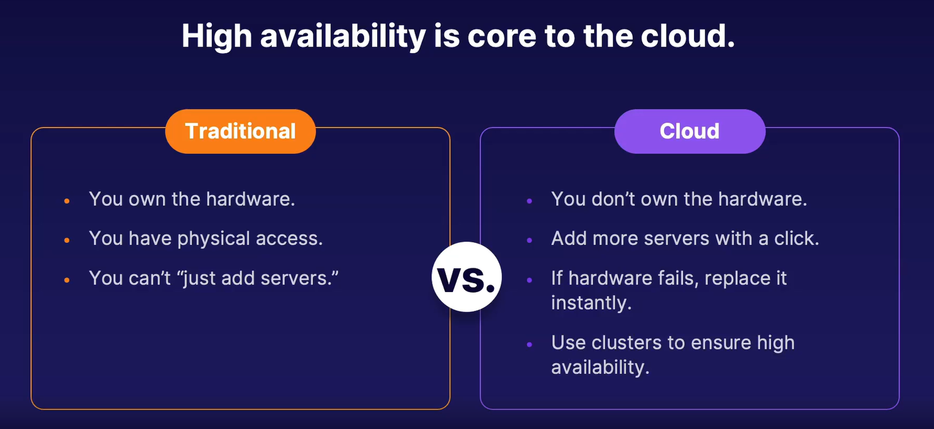
High Availability

Slide 128
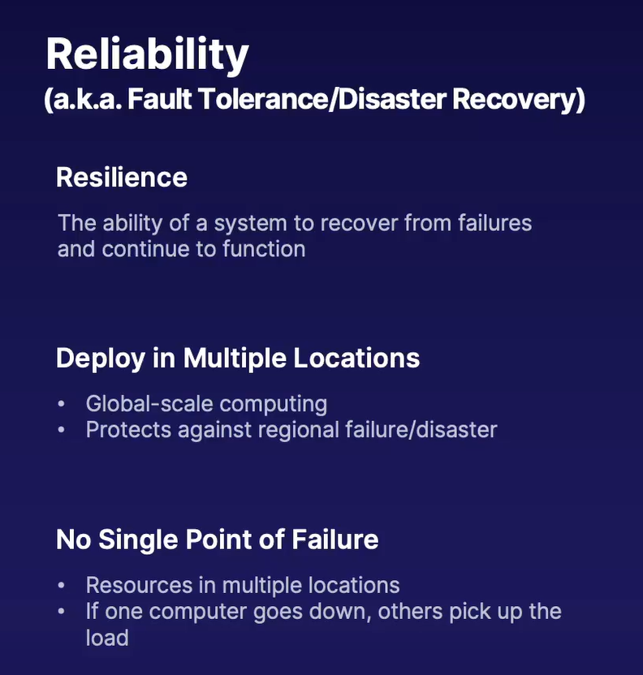

Slide 129
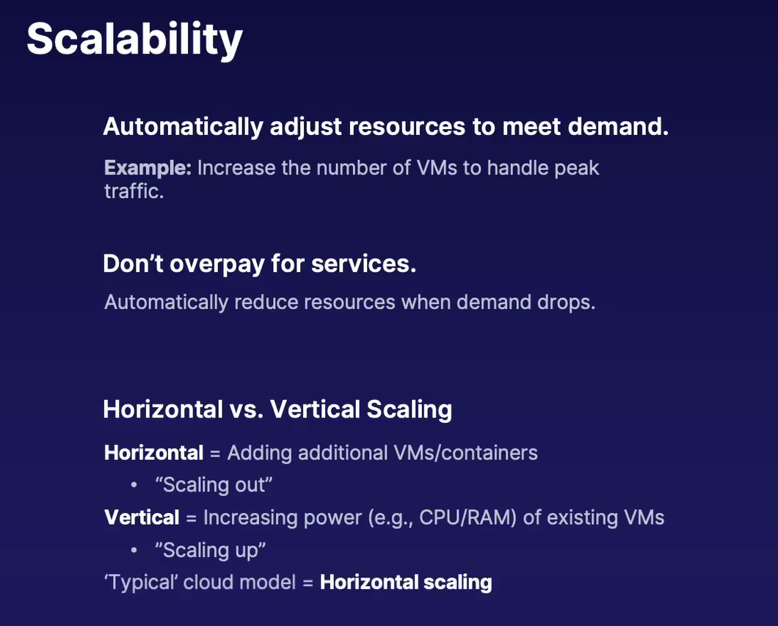

Slide 130
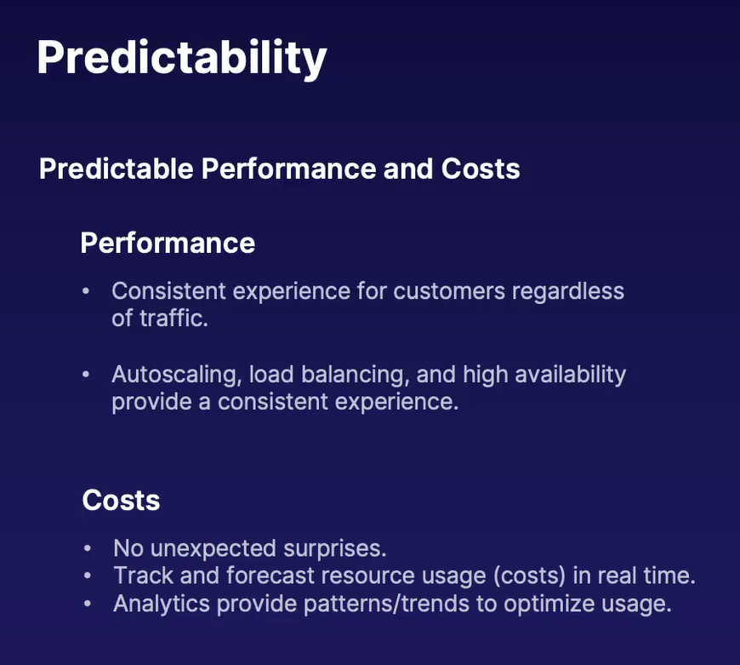

Slide 131
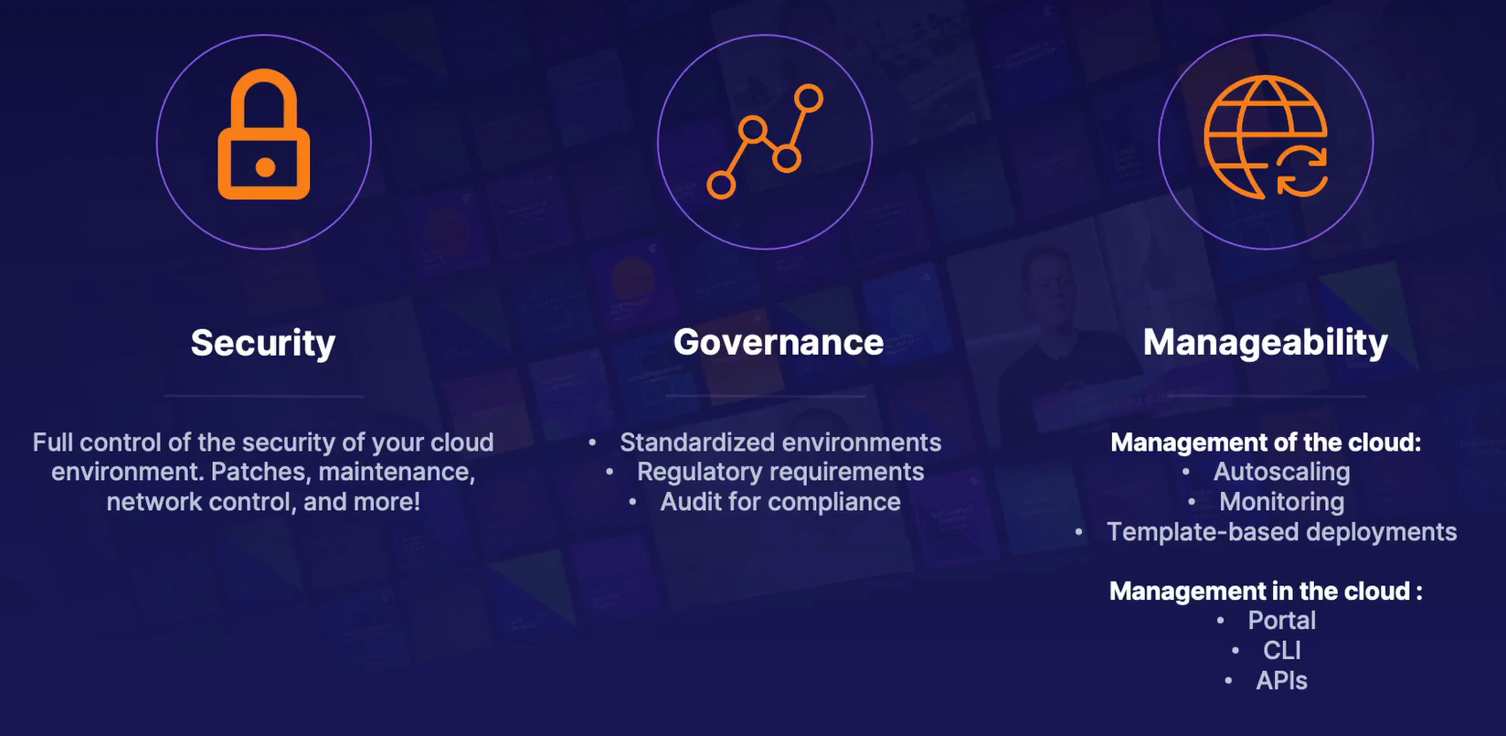

Slide 132
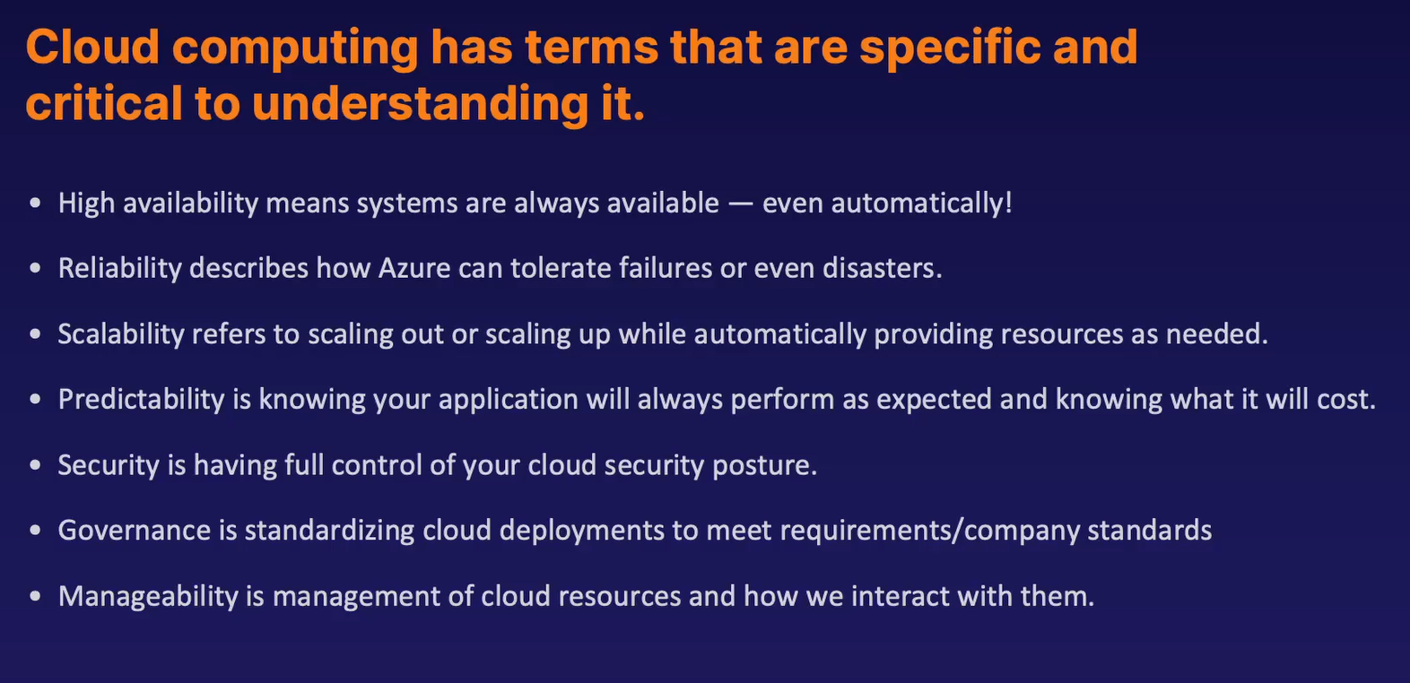

Slide 133
How cloud fits in Consumption-based model?

Slide 134
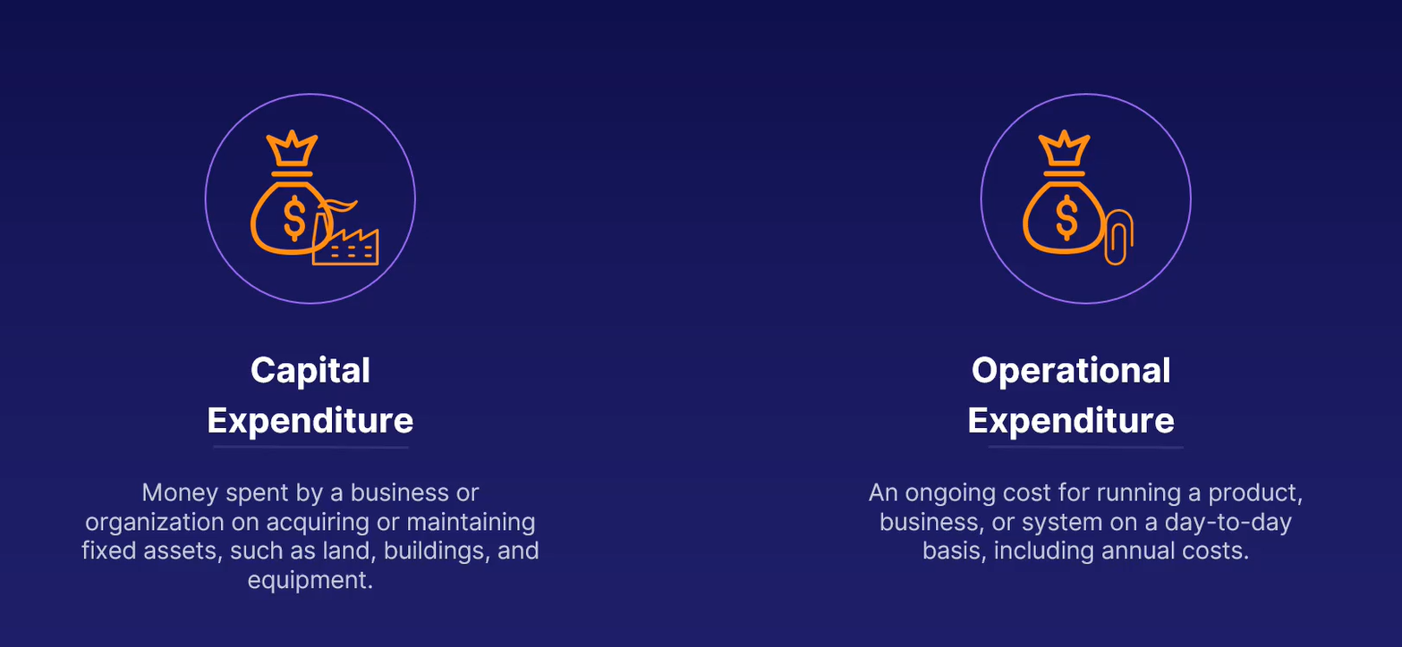

Slide 135
Consumption-based model
Cloud computing falls under OpEx because cloud computing operates on a consumption-based model.
With cloud computing, you don’t pay for the physical infrastructure, the electricity, the security, or anything else associated with maintaining a datacenter.
Consumption-based model has many benefits, including:
No upfront costs.
No need to purchase and manage costly infrastructure that users might not use to its fullest potential.
The ability to pay for more resources when they're needed.
The ability to stop paying for resources that are no longer needed.

Slide 136
Shared Responsibility
A shared responsibility model is a cloud security framework that dictates the security obligations of a cloud computing provider and its users to ensure accountability.

Slide 137
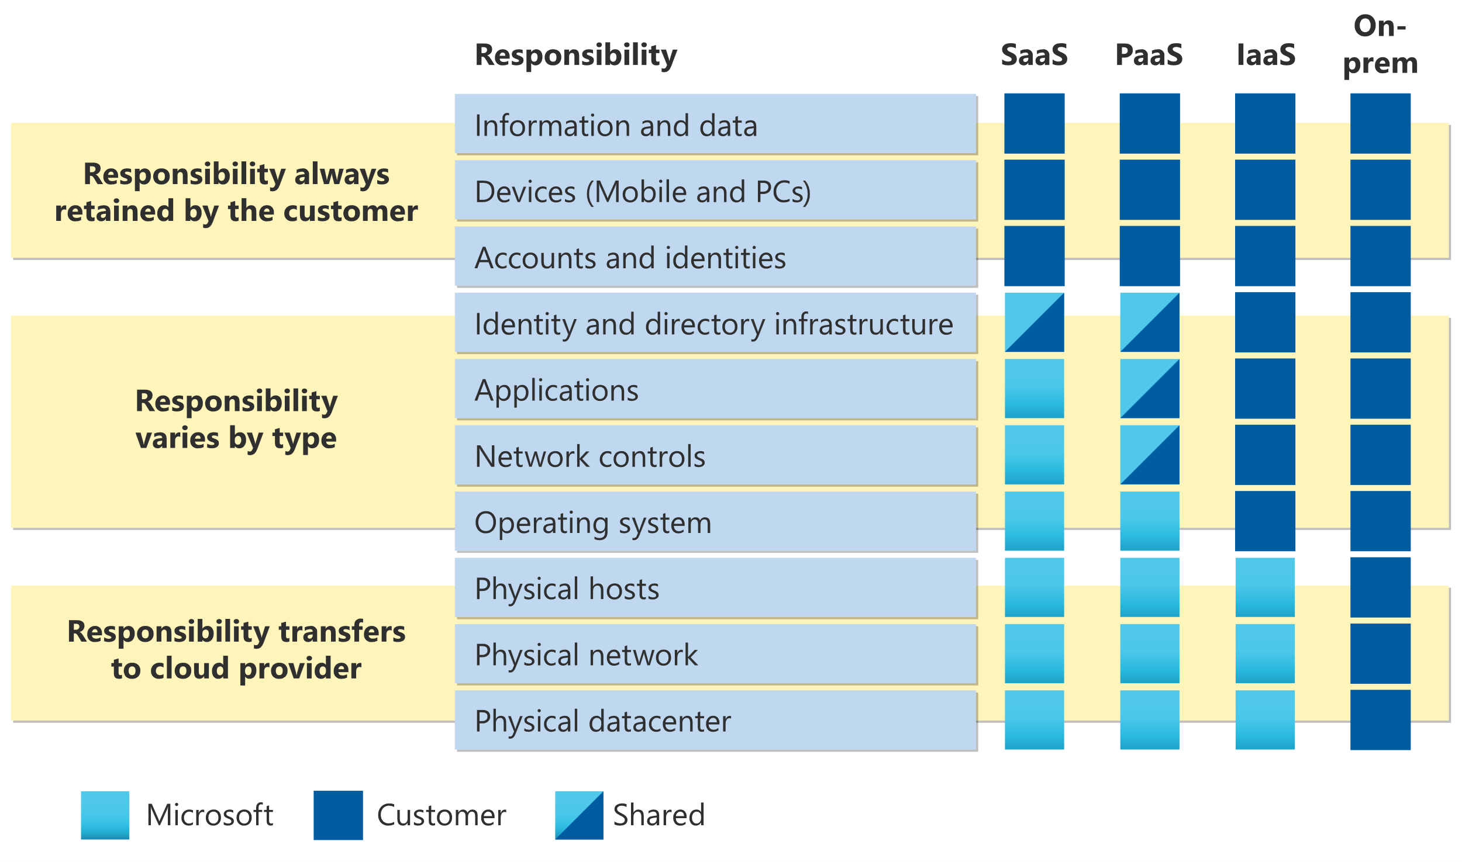

Slide 138
Shared Responsibility
You’ll always be responsible for:
The information and data stored in the cloud
Devices that are allowed to connect to your cloud (cell phones, computers, and so on)
The accounts and identities of the people, services, and devices within your organization
The cloud provider is always responsible for:
The physical datacenter
The physical network
The physical hosts
Your service model will determine responsibility for things like:
Operating systems
Network controls
Applications
Identity and infrastructure

Slide 139
Cloud Models
The cloud models define the deployment type of cloud resources.
The three main cloud models are:
Private
Public
Hybrid

Slide 140
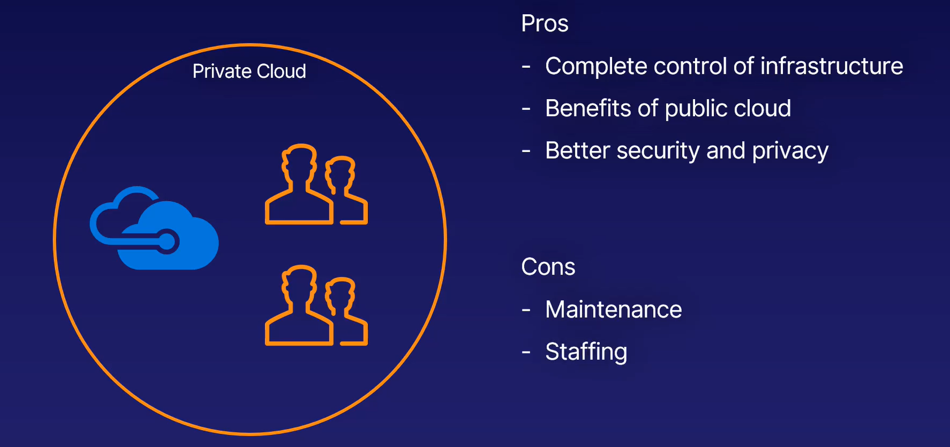
Private Cloud
A private cloud is, in some ways, the natural evolution from a corporate datacenter.
Private cloud provides much greater control for the company and its IT department.

Slide 141
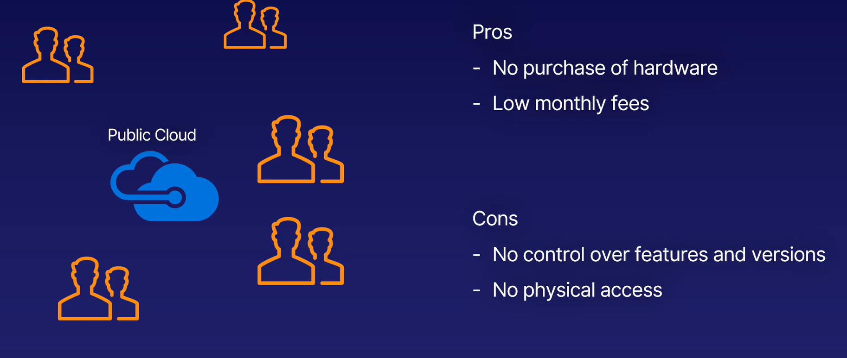
Public cloud
A public cloud is built, controlled, and maintained by a third-party cloud provider.
With a public cloud, anyone that wants to purchase cloud services can access and use resources.

Slide 142
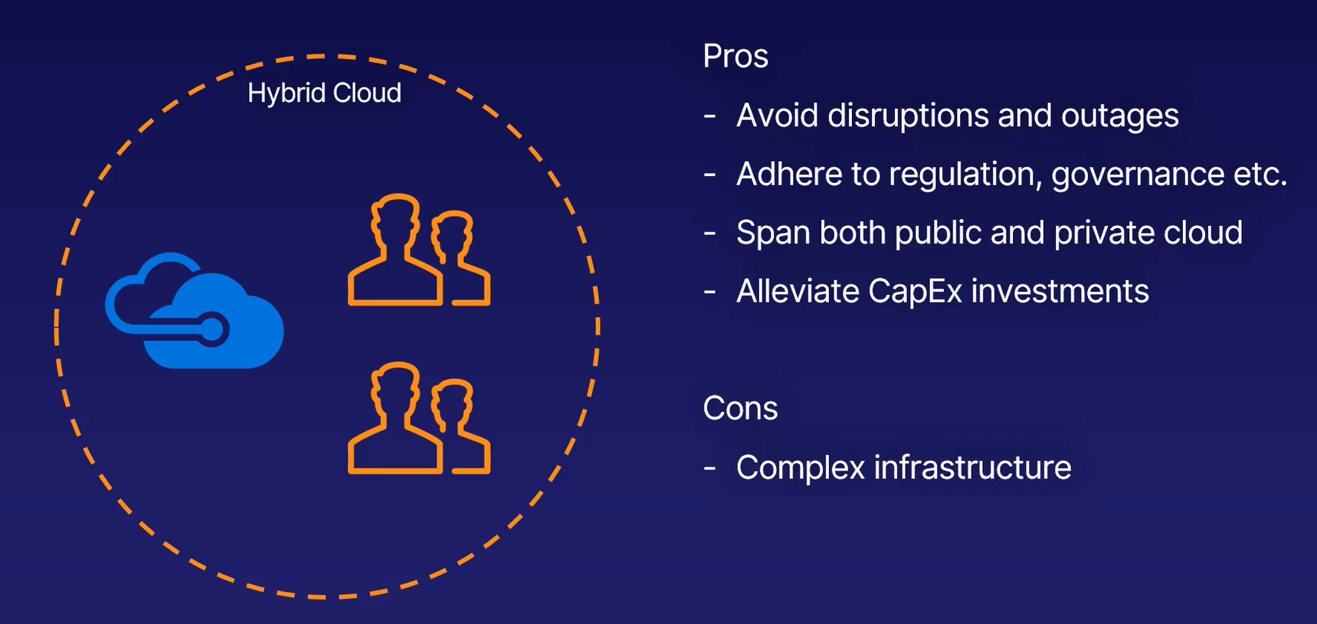
Hybrid cloud
A hybrid cloud is a computing environment that uses both public and private clouds in an inter-connected environment.
A hybrid cloud environment can be used to allow a private cloud to surge for increased, temporary demand by deploying public cloud resources.

Slide 143
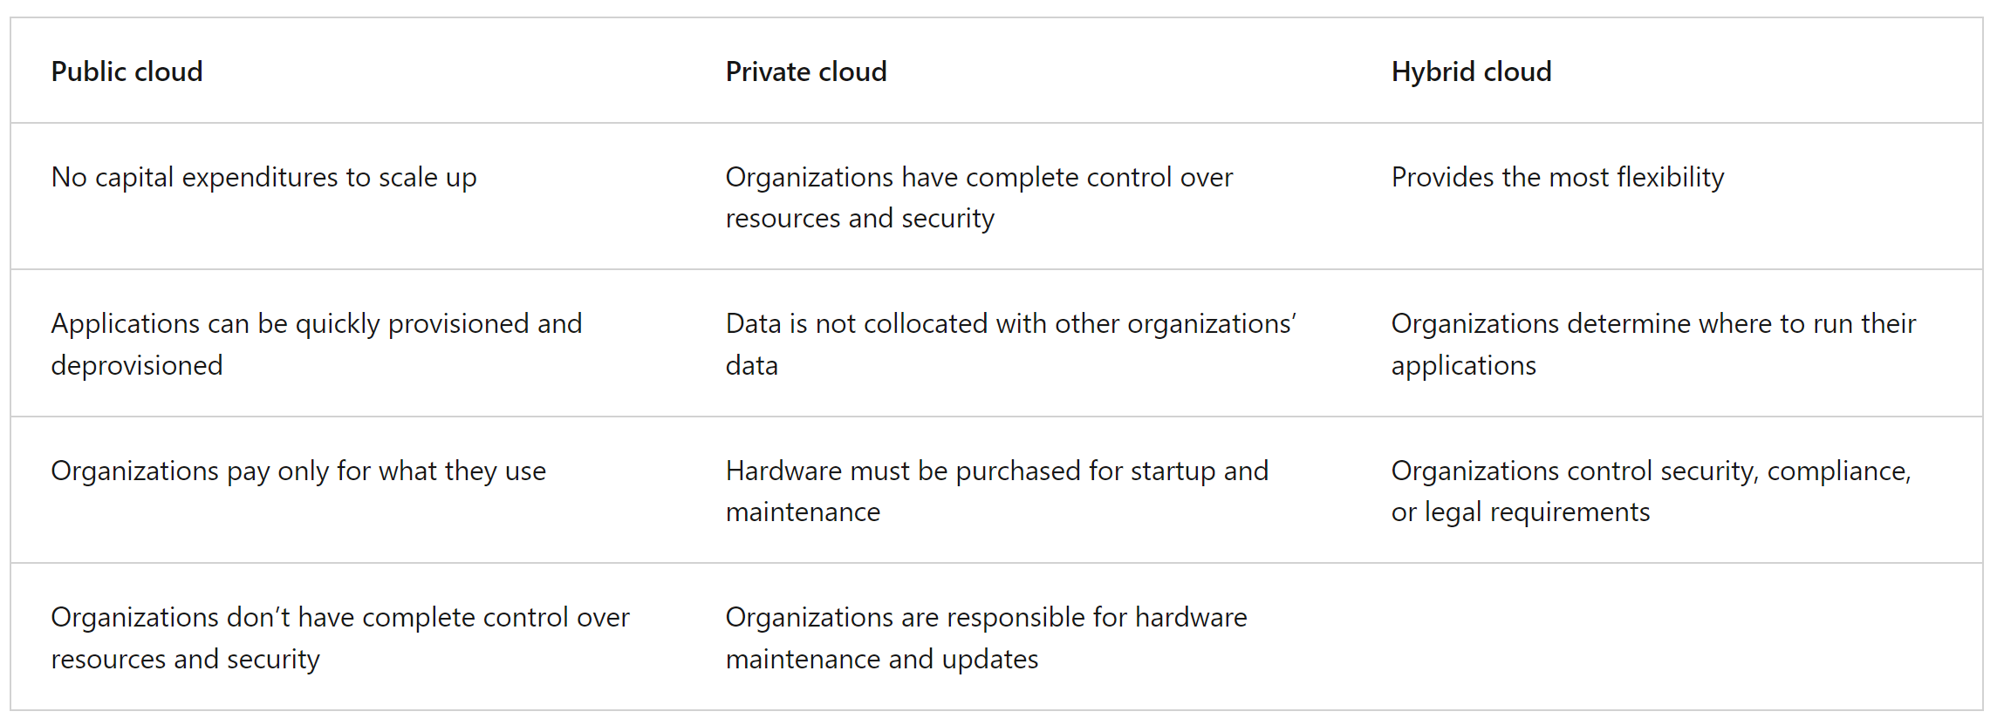

Slide 144
Multi-cloud
A fourth, and increasingly likely scenario is a multi-cloud scenario. In a multi-cloud scenario, you use multiple public cloud providers.
Maybe you use different features from different cloud providers. Or maybe you started your cloud journey with one provider and are in the process of migrating to a different provider.
Regardless, in a multi-cloud environment you deal with two (or more) public cloud providers and manage resources and security in both environments.

Slide 145
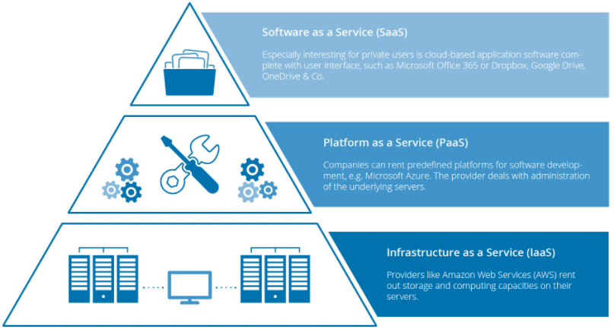
Cloud Service Models

Slide 146
Cloud Service Models
There are the following three types of cloud service models -
Infrastructure as a Service (IaaS)
Platform as a Service (PaaS)
Software as a Service (SaaS)

Slide 147
Infrastructure as a Service (IaaS)
IaaS is also known as Hardware as a Service (HaaS). It is a computing infrastructure managed over the internet.
The main advantage of using IaaS is that it helps users to avoid the cost and complexity of purchasing and managing the physical servers.
Characteristics of IaaS
Resources are available as a service
Services are highly scalable
Dynamic and flexible
GUI and API-based access
Automated administrative tasks
Example: DigitalOcean, Linode, Amazon Web Services (AWS), Microsoft Azure, Google Compute Engine (GCE), Rackspace, and Cisco Metacloud.

Slide 148
Platform as a Service (PaaS)
PaaS cloud computing platform is created for the programmer to develop, test, run, and manage the applications.
Characteristics of PaaS
Accessible to various users via the same development application.
Integrates with web services and databases.
Builds on virtualization technology, so resources can easily be scaled up or down as per the organization's need.
Support multiple languages and frameworks.
Provides an ability to "Auto-scale".
Example: AWS Elastic Beanstalk, Windows Azure, Heroku, Force.com, Google App Engine, Apache Stratos, Magento Commerce Cloud, and OpenShift.

Slide 149
Software as a Service (SaaS)
SaaS is also known as "on-demand software". It is a software in which the applications are hosted by a cloud service provider.
Users can access these applications with the help of internet connection and web browser.
Characteristics of SaaS
Managed from a central location
Hosted on a remote server
Accessible over the internet
Users are not responsible for hardware and software updates. Updates are applied automatically.
The services are purchased on the pay-as-per-use basis
Example: Office 365, Google Apps, Salesforce, Dropbox, ZenDesk, Cisco WebEx, ZenDesk, Slack, and GoToMeeting.

Slide 150
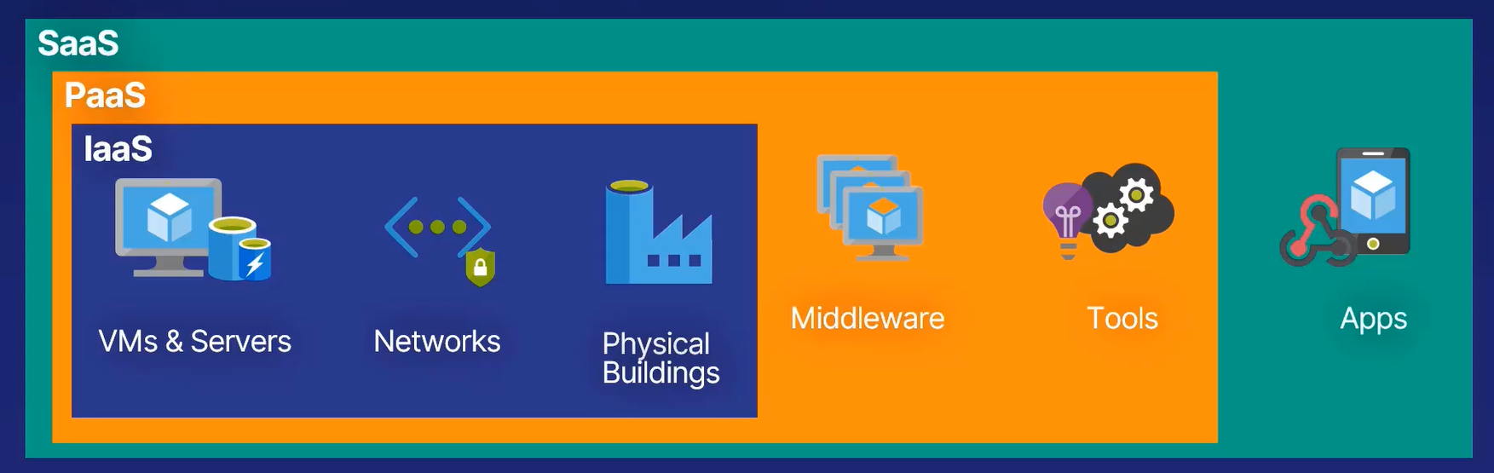

Slide 151
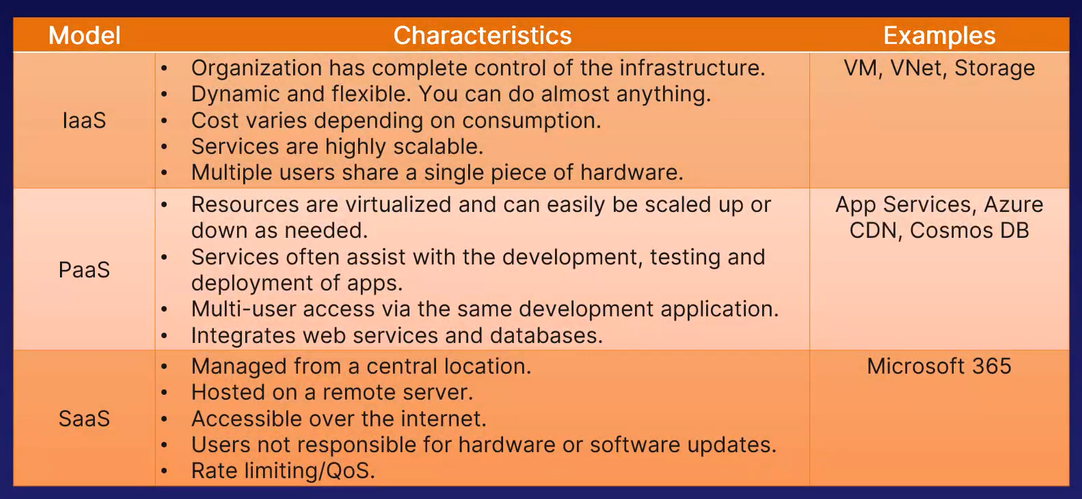

Slide 152
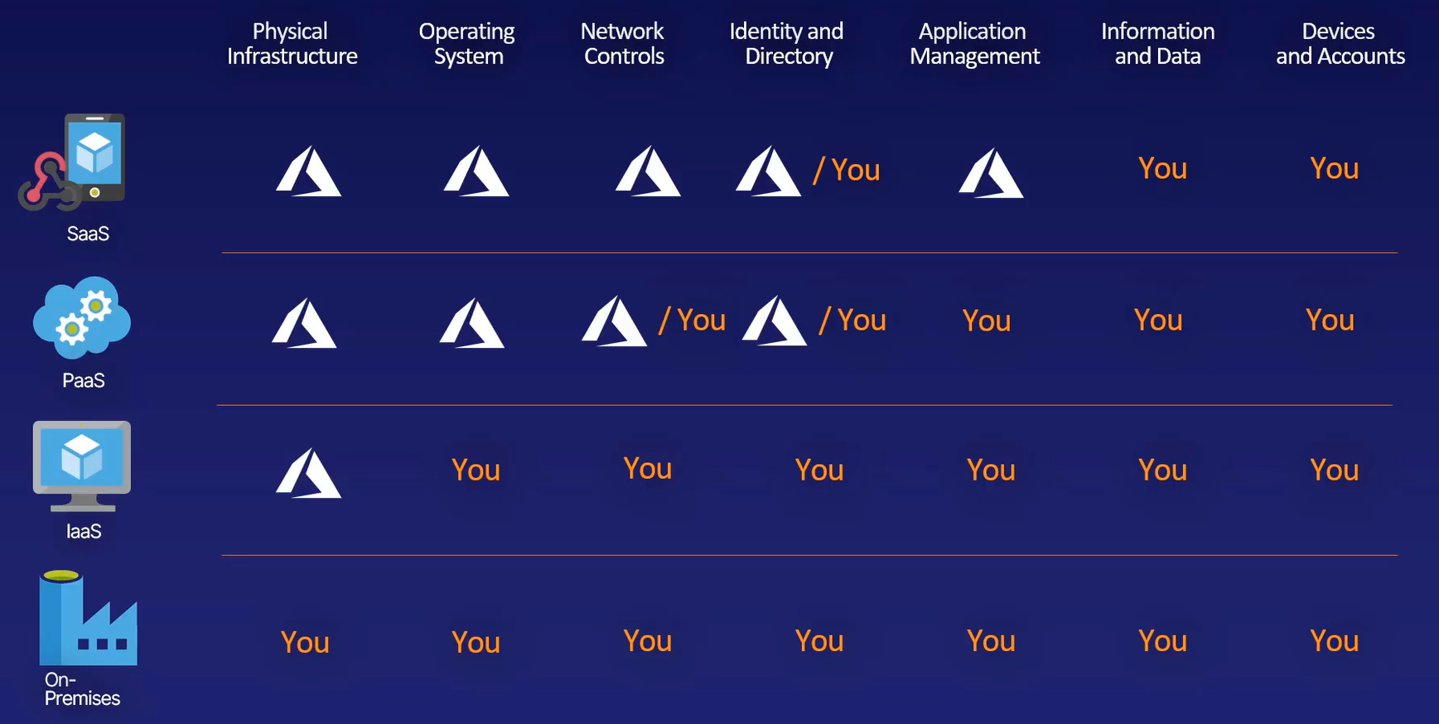

Slide 153
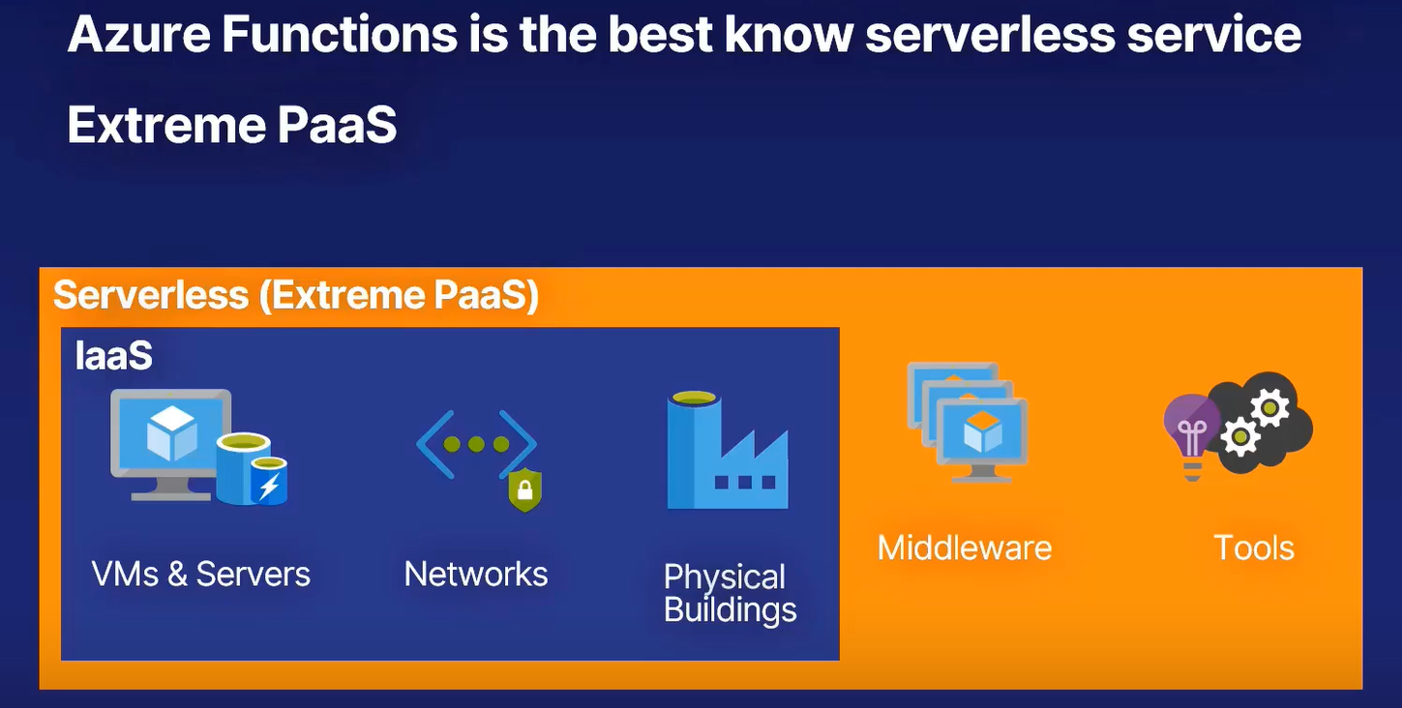
Serverless

Slide 154
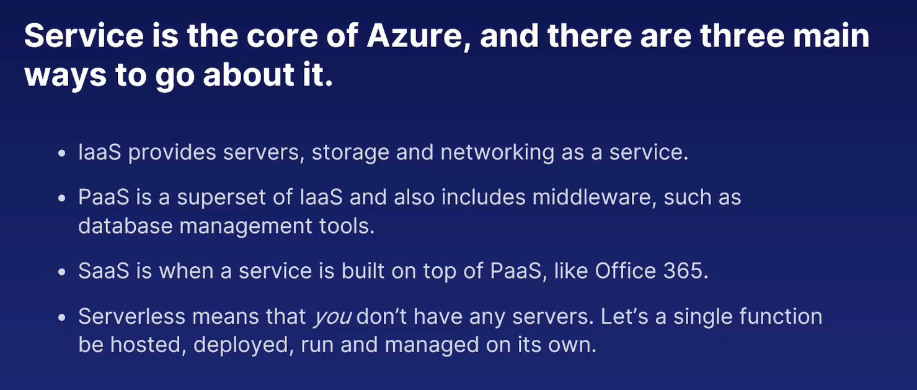

Slide 155
Azure Marketplace
Azure Marketplace is an online store that contains thousands of IT software applications and services built by industry-leading technology companies.
In Azure Marketplace you can find, try, buy, and deploy the software and services you need to build new solutions and manage your cloud infrastructure.
The catalog includes solutions for different industries and technical areas, free trials, and consulting services from Microsoft partners.

Slide 156
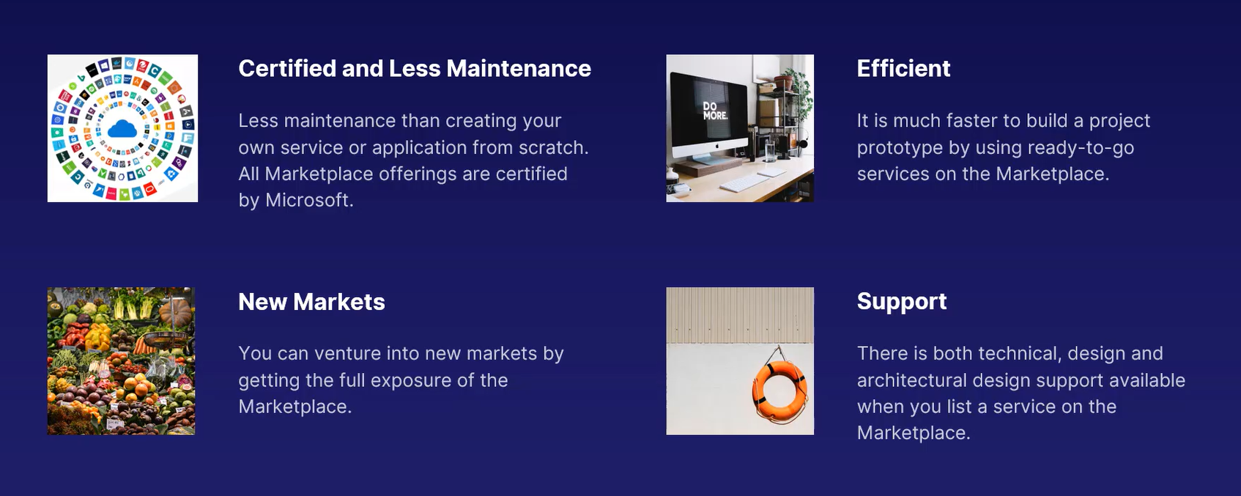
Benefits of Azure Marketplace

Slide 157
What is Azure?
Azure is the only consistent hybrid cloud, delivers access, management, and development of applications and services via around the world-distributed data centers.

Slide 158
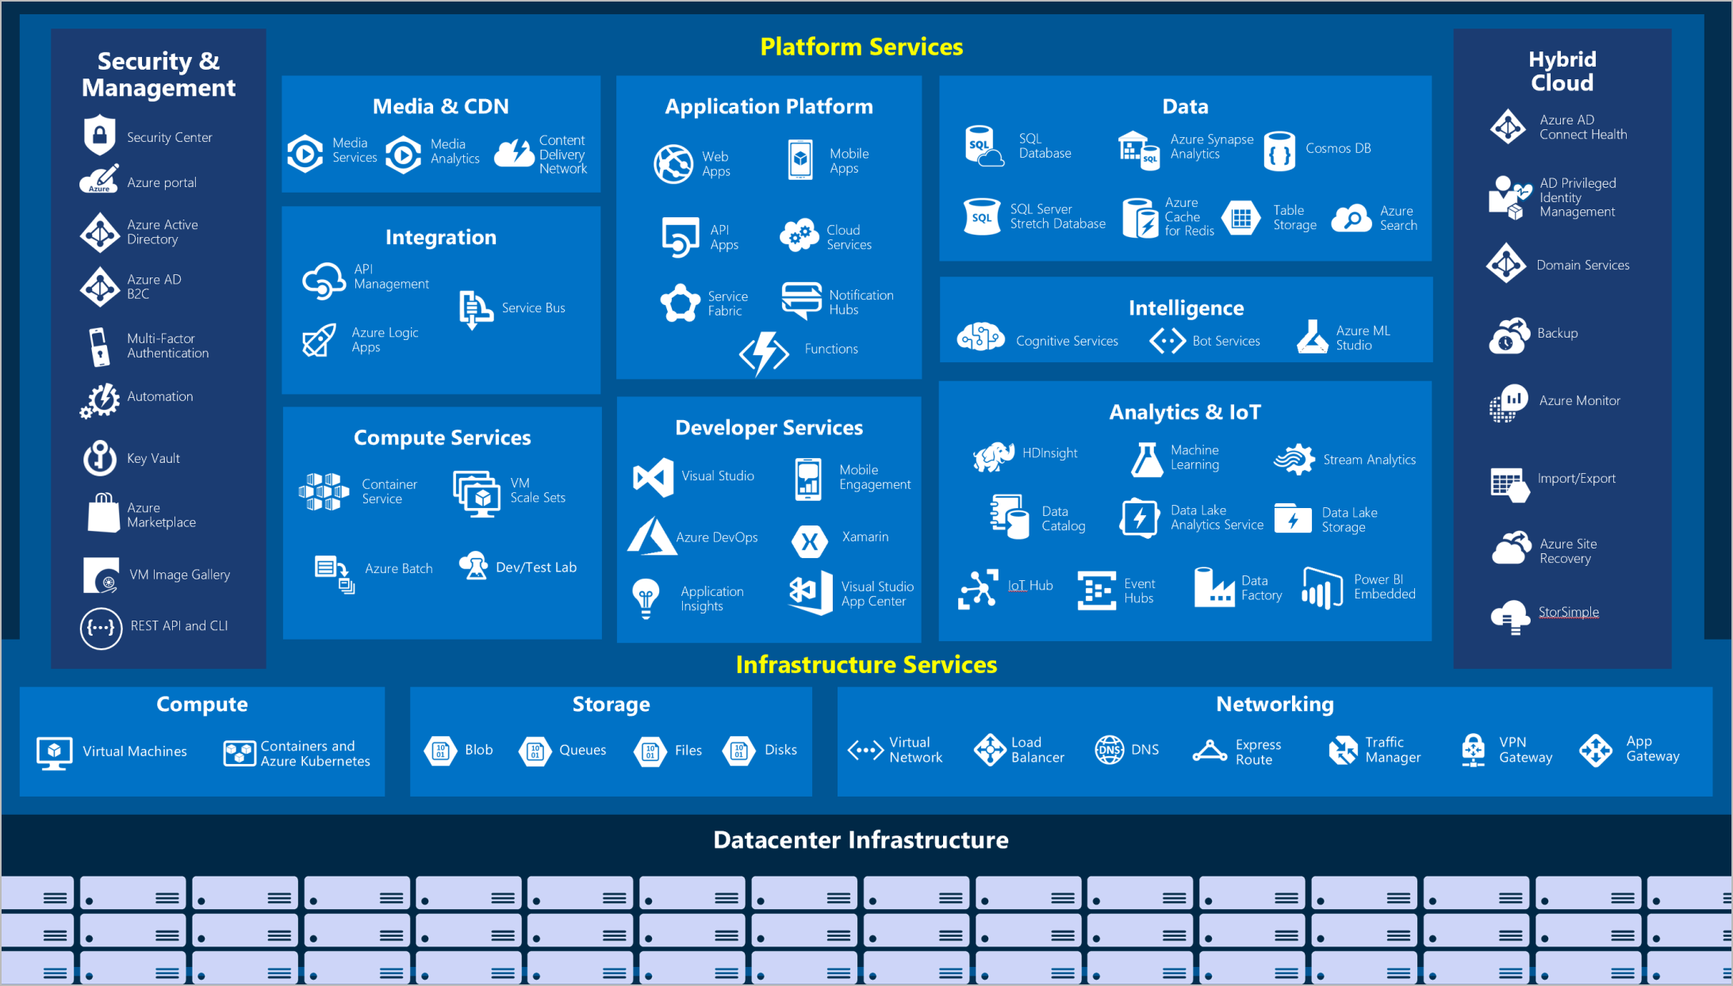

Slide 159
How to Access Azure Services?

Slide 160
Azure Portal
The Azure portal is a web-based, unified console that provides an alternative to command-line tools.
With the Azure portal, you can manage your Azure subscription using a graphical user interface.
You can build, manage, and monitor everything from simple web apps to complex cloud deployments in the portal.

Slide 161
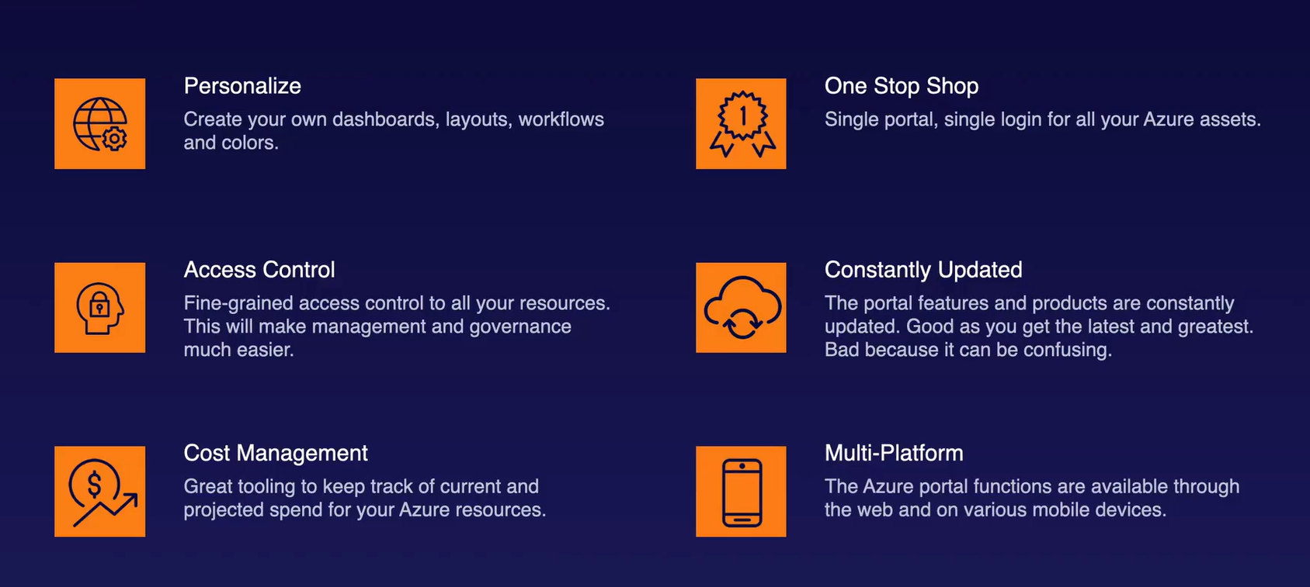
Portal Features

Slide 162
Azure CLI
The Azure Command-Line Interface (CLI) is a cross-platform command-line tool to connect to Azure and execute administrative commands on Azure resources.
It allows the execution of commands through a terminal using interactive command-line prompts or a script.

Slide 163
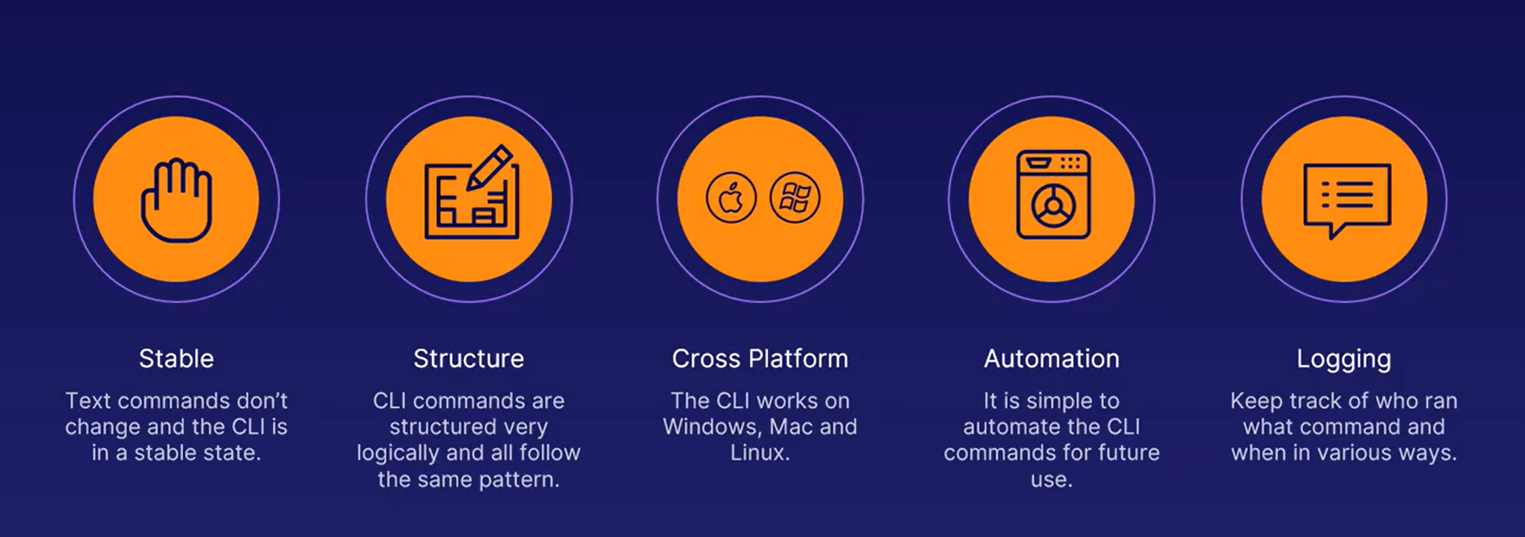
Azure CLI Advantages

Slide 164
Azure Powershell
Azure PowerShell is a set of cmdlets for managing Azure resources directly from PowerShell.
Azure PowerShell is designed to make it easy to learn and get started with, but provides powerful features for automation.
The Az PowerShell module is based on the .NET Standard, and works with PowerShell 7.0.6 LTS and PowerShell 7.1.3 or higher on all platforms

Slide 165
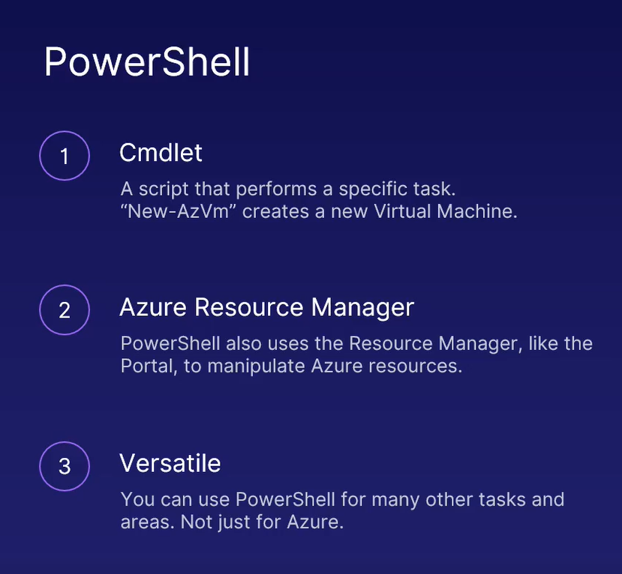
Azure PowerShell Features

Slide 166
Cloud Shell
Azure Cloud Shell is a browser-based shell experience to manage and develop Azure resources.
Cloud Shell offers a browser-accessible, pre-configured shell experience for managing Azure resources without the overhead of installing, versioning, and maintaining a machine yourself.
Cloud Shell allocates machines on a per-request basis and as a result machine state doesn't persist across sessions.

Slide 167
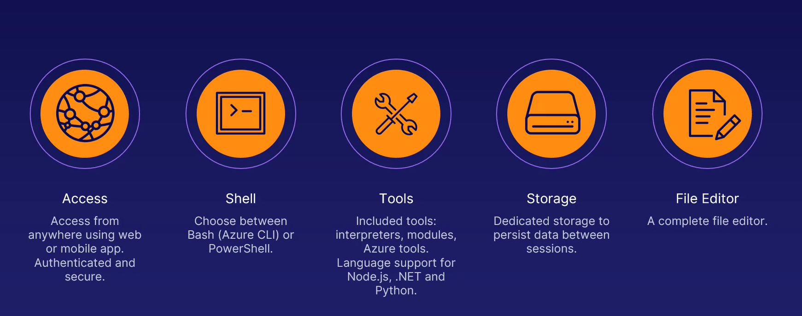
Cloud Shell Features

Slide 168
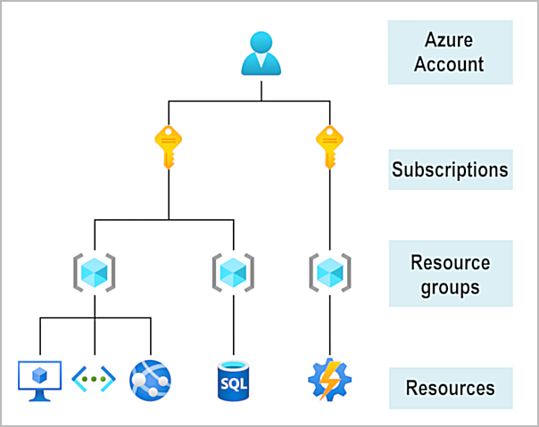
Azure Access
To create and use Azure services, you need an Azure subscription.
Your company might use a single Azure account for your business and separate subscriptions for development, marketing, and sales departments.

Slide 169
Azure - Core architectural components
The core architectural components of Azure may be broken down into two main groupings:
The physical infrastructure
The management infrastructure.

Slide 170
Azure physical infrastructure
The physical infrastructure for Azure starts with datacenters.
As a global cloud provider, Azure has datacenters around the world.
Datacenters are grouped into Azure Regions or Azure Availability Zones that are designed to help you achieve resiliency and reliability for your business-critical workloads.

Slide 171
Regions
A region is a geographical area on the planet that contains at least one, but potentially multiple datacenters that are nearby and networked together with a low-latency network.
Azure intelligently assigns and controls the resources within each region to ensure workloads are appropriately balanced.
When you deploy a resource in Azure, you'll often need to choose the region where you want your resource deployed.

Slide 172
Availability Zones
Availability zones are physically separate datacenters within an Azure region.
Each availability zone is made up of one or more datacenters equipped with independent power, cooling, and networking.
An availability zone is set up to be an isolation boundary. If one zone goes down, the other continues working.
Availability zones are connected through high-speed, private fiber-optic networks.

Slide 173
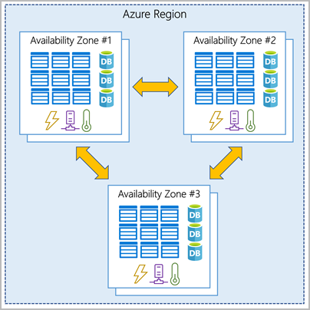

Slide 174
Region pairs
Most Azure regions are paired with another region within the same geography (such as US, Europe, or Asia) at least 300 miles away.
This approach allows for the replication of resources across a geography that helps reduce the likelihood of interruptions because of events such as natural disasters, civil unrest, power outages, or physical network outages that affect an entire region.
For example, if a region in a pair was affected by a natural disaster, services would automatically fail over to the other region in its region pair.

Slide 175
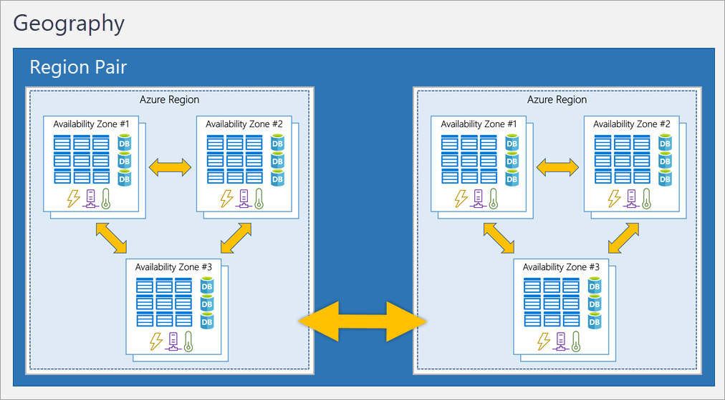

Slide 176
Azure management infrastructure
The management infrastructure includes Azure resources and resource groups, subscriptions, and accounts.
Understanding the hierarchical organization will help you plan your projects and products within Azure.

Slide 177
Azure resources and resource groups
A resource is the basic building block of Azure. Anything you create, provision, deploy, etc. is a resource.
Virtual Machines (VMs), virtual networks, databases, cognitive services, etc. are all considered resources within Azure.
Resource groups are simply groupings of resources.
When you create a resource, you’re required to place it into a resource group.
While a resource group can contain many resources, a single resource can only be in one resource group at a time.

Slide 178
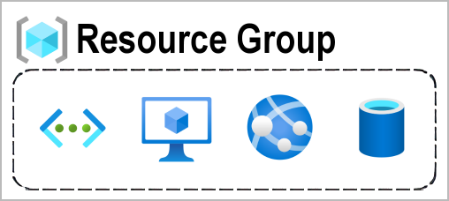
Azure resources and resource groups

Slide 179
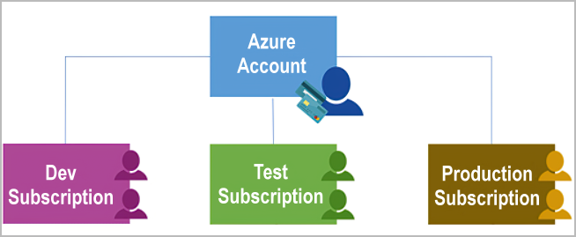
Azure subscriptions
In Azure, subscriptions are a unit of management, billing, and scale.
Like how resource groups are a way to logically organize resources, subscriptions allow you to logically organize your resource groups and facilitate billing.

Slide 180
Azure management groups
If you have many subscriptions, you might need a way to efficiently manage access, policies, and compliance for those subscriptions.
Azure management groups provide a level of scope above subscriptions.
You organize subscriptions into containers called management groups and apply governance conditions to the management groups.

Slide 181
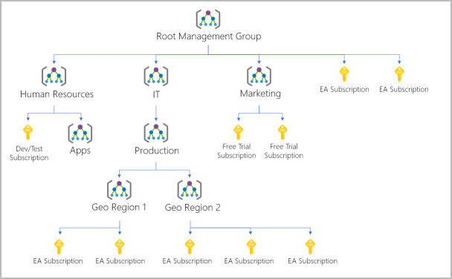

Slide 182
Azure app service
App Service is a Platform as a Service (PaaS) offering from Microsoft.
We use it to host
Web applications
REST API’s
Backend services for mobile applications.
It doesn't really matter which programming language or framework you have used.
It could be
.NET
.NET Core
Java
Ruby
Node.js
PHP
Python

Slide 183
Benefits of using azure app service
Fully managed environment
It's a fully managed environment, meaning App Service automatically patches and maintains the OS and language frameworks for you.
Multiple programming languages and frameworks are supported.
Scalability
Based on the demand for your application, App Service can scale resources up and down or in and out.
Compliance
App Service is ISO, SOC and PCI compliant.
Security
Authenticate users with Azure Active Directory or any of the external authentication providers like Google, Facebook, Twitter, or Microsoft.
Support for Containerization and Docker
You can also host a custom Windows or Linux container in App Service.
DevOps optimization
Access on-premises / cloud data

Slide 184
App service plan
To create App Service, you need an App Service Plan.
It is the App Service Plan that defines the compute resources required for your application to run.
Just like any other resource in azure. Search for App Service Plans in the azure portal and click Create.
Name - A name for the App Service Plan.
Operating System - The operating system that you want on the underlying virtual machine - Windows or Linux.
Region - The region where you want the App Service Plan to be created.
Pricing Tier - It is the pricing tier that determines what you pay and what you get.

Slide 185
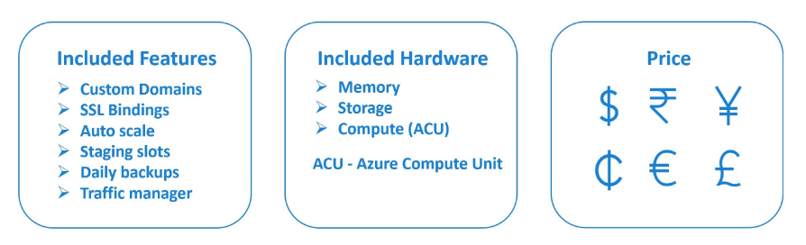
App Service Plan – Pricing Tier
Pricing tier determines what you pay and what you get.
The pricing tier you select, determines the following 3 things.

Slide 186
Azure Cosmos DB

Slide 187
What is a Database?
A database is a collection of data that is organized so that it can be easily retrieved and managed.
A database is typically stored in a computer system, so that the applications associated with it can access it.
It is also associated with a database management system which can be used to create, edit or update them.
The term database is most often used to represent both the database and the database management system.

Slide 188
Types of databases
There are different types of databases depending on the way we intend to use it.
They are:
Relational databases
Object-oriented databases
Distributed databases
Data warehouses
NoSQL databases
Graph databases
OLTP databases.
Open source databases
Cloud databases
Multi Model database
Document/JSON database
Self-driving databases

Slide 189
Main Types
Relational Database
A relational database is used to store data that is related to one another. In a relational model, data is stored in the form of tables as rows and columns.
NoSQL Database
NoSQL databases are used for data modeled in ways that are not like relational databases. The data structures like key-value pair, wide column, graph, or document are not like those used in relational databases and are supported in NoSQL.
Distributed Database
When data in a database is stored in different physical locations it is called a distributed database.
Multi Model Database
A database model that can support both the relational data models as well as the NoSQL models is called Multi-Model Databases.

Slide 190
Azure Cosmos DB
Cosmos Database (DB) is a globally distributed, low latency, multi-model database for managing data at large scales.
It is a cloud-based NoSQL database offered as a PaaS (Platform as a Service) from Microsoft Azure.
It is a highly available, high throughput, reliable database and is often called a serverless database.
Cosmos database contains the Azure Document DB and is available everywhere.
Cosmos DB has multi-master support where the data can be simultaneously written into different databases spread out globally.

Slide 191
APIs in Azure Cosmos DB
Azure Cosmos DB offers multiple database APIs, which include NoSQL, MongoDB, PostgreSQL Cassandra, Gremlin, and Table.
By using these APIs, you can model real world data using documents, key-value, graph, and column-family data models.
These APIs allow your applications to treat Azure Cosmos DB as if it were various other databases technologies, without the overhead of management, and scaling approaches.
All the APIs offer automatic scaling of storage and throughput, flexibility, and performance guarantees.

Slide 192
APIs in Azure Cosmos DB
Azure Cosmos DB for NoSQL
Azure Cosmos DB for MongoDB
Azure Cosmos DB for PostgreSQL
Azure Cosmos DB for Apache Cassandra
Azure Cosmos DB for Apache Gremlin
Azure Cosmos DB for Azure Table

Slide 193
Azure Storage
The Azure Storage platform is Microsoft's cloud storage solution for modern data storage scenarios.
Azure Storage offers highly available, massively scalable, durable, and secure storage for a variety of data objects in the cloud.
Azure Storage data objects are accessible from anywhere in the world over HTTP or HTTPS via a REST API.
Azure Storage also offers client libraries for developers building applications or services with .NET, Java, Python, JavaScript, C++, and Go.

Slide 194
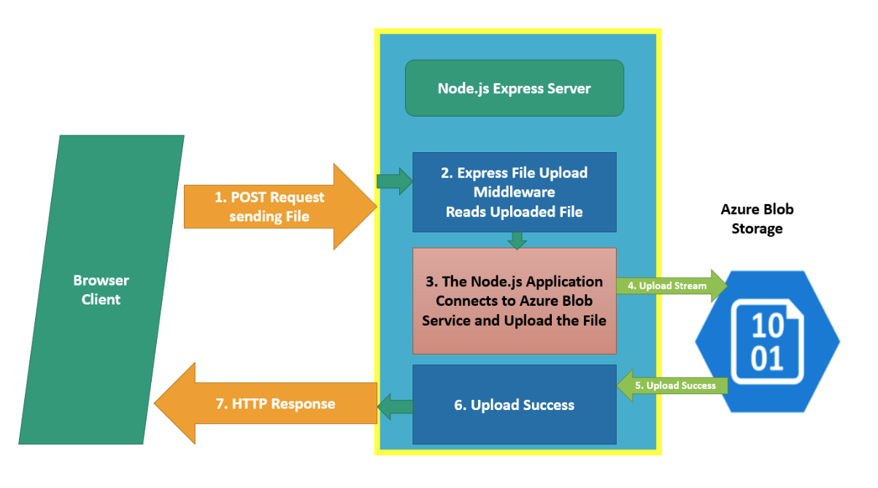

Slide 195
Azure Functions

Slide 196
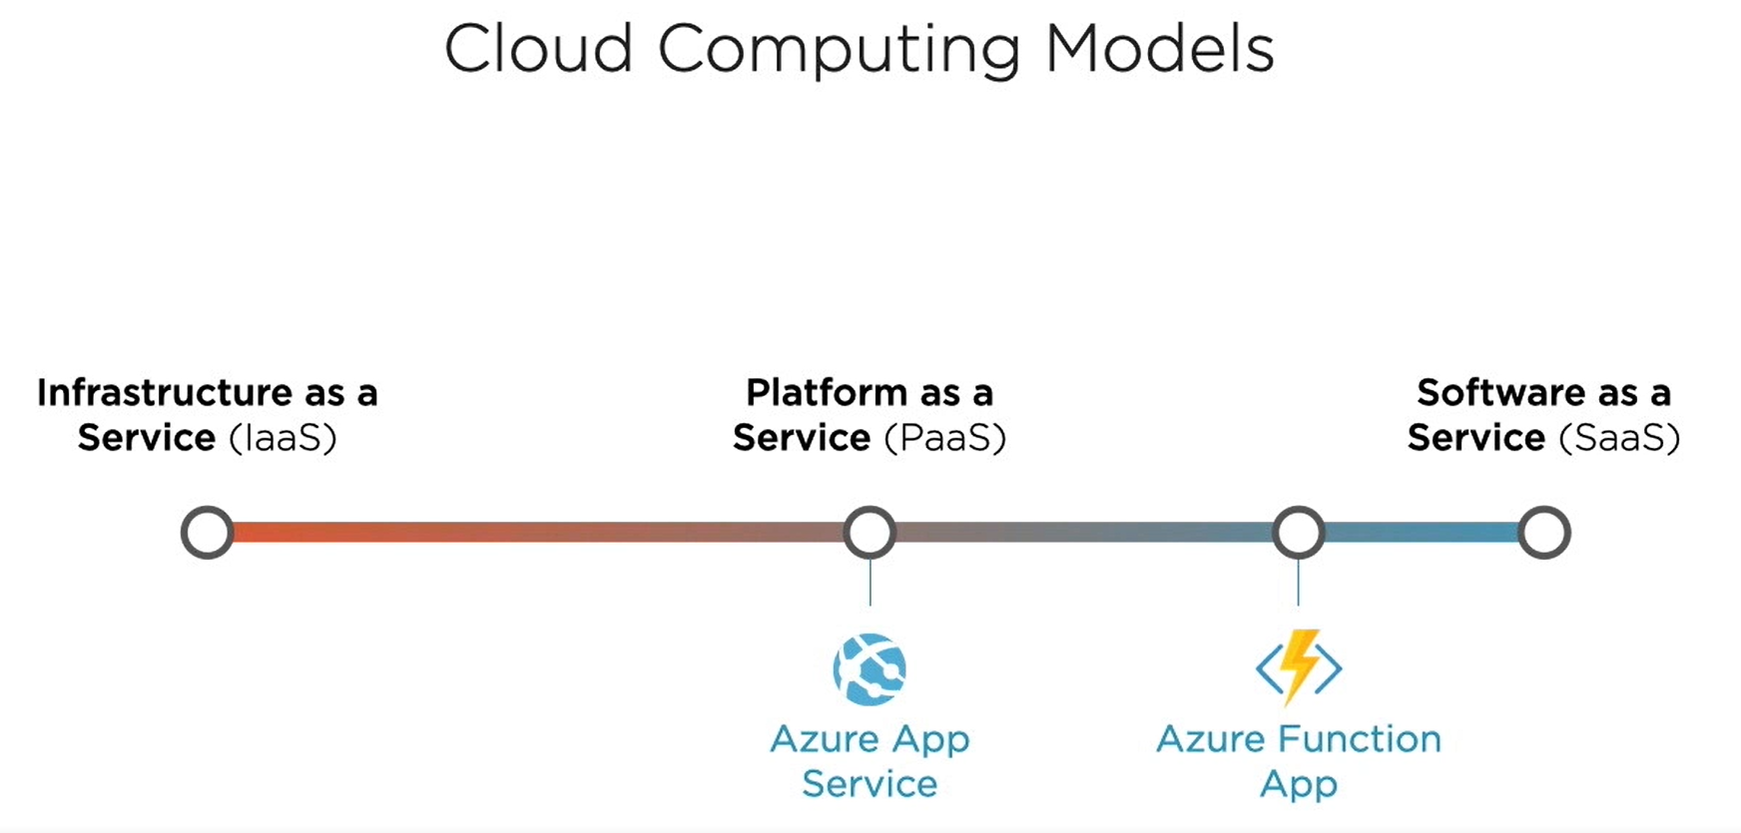

Slide 197
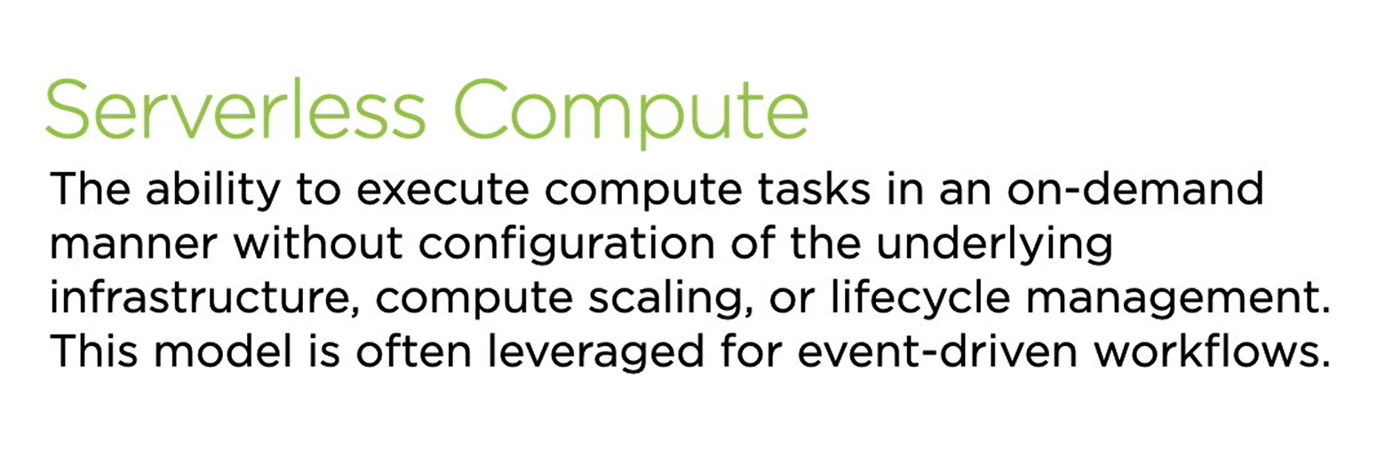

Slide 198
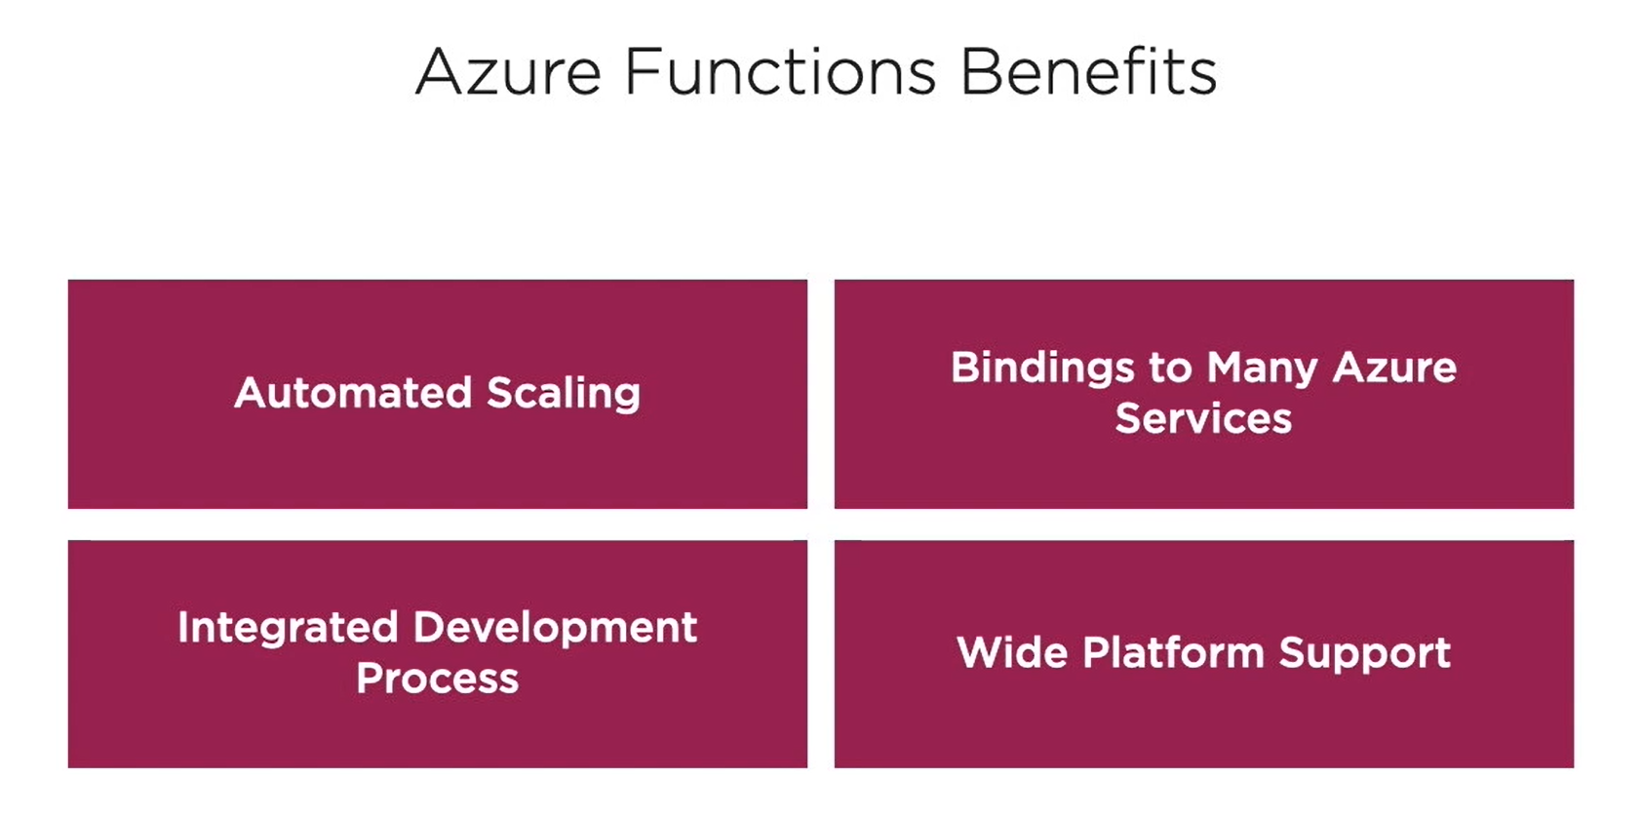

Slide 199
Azure Functions Platform Support
C#
JavaScript
F#
Java
PowerShell
Python
TypeScript

Slide 200
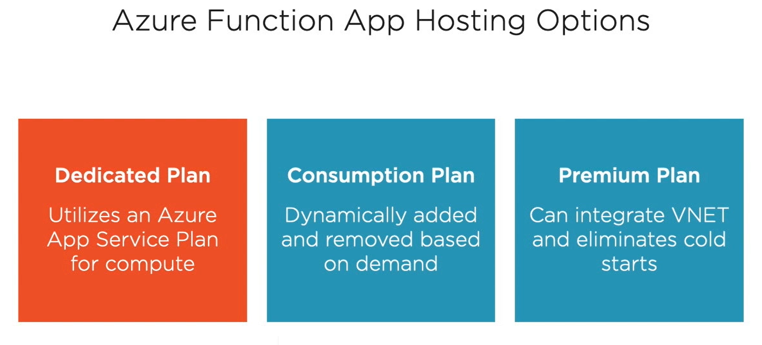

Slide 201
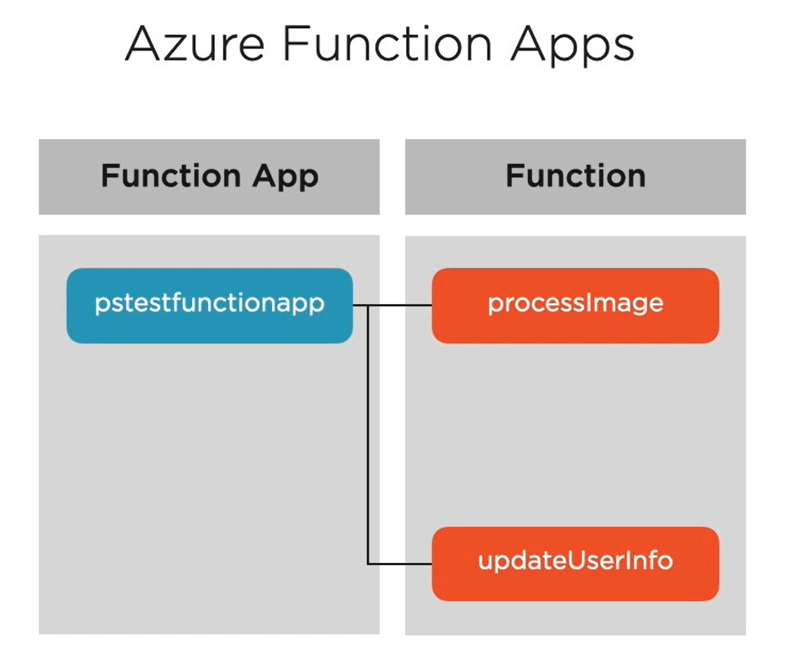
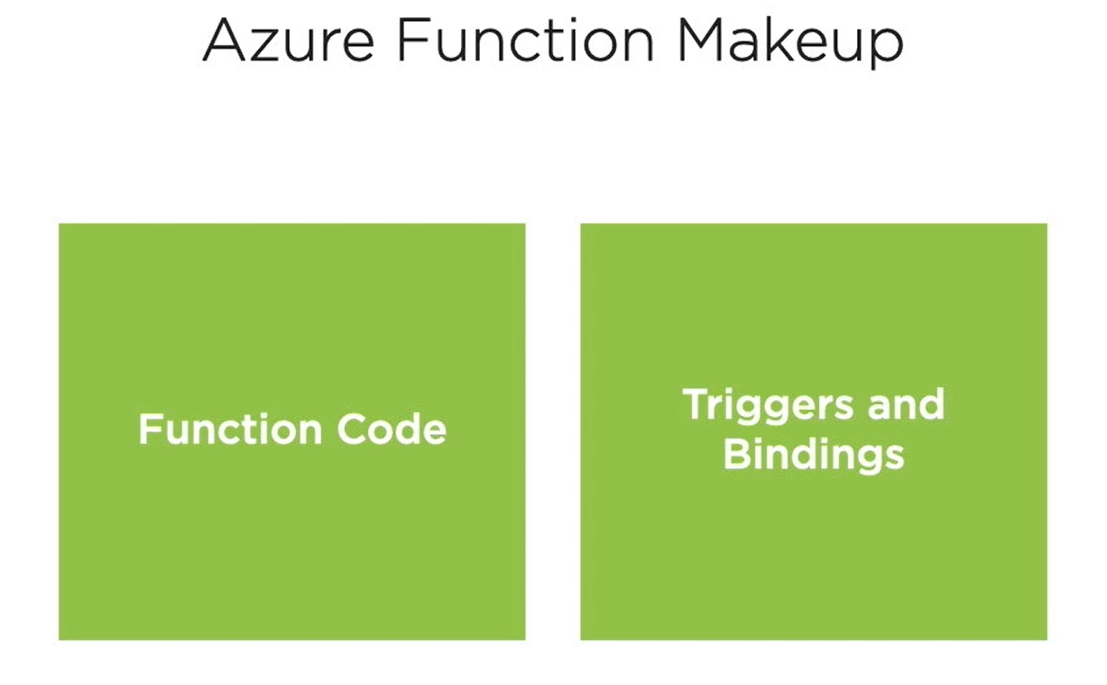

Slide 202
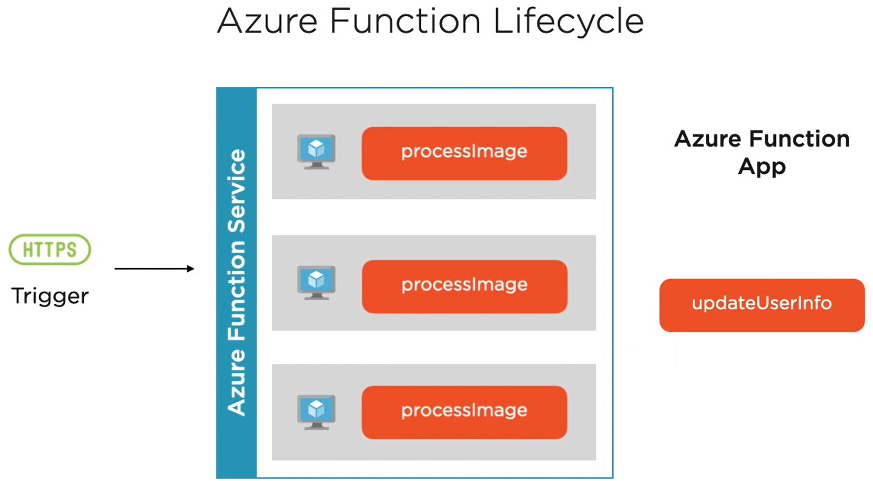

Slide 203
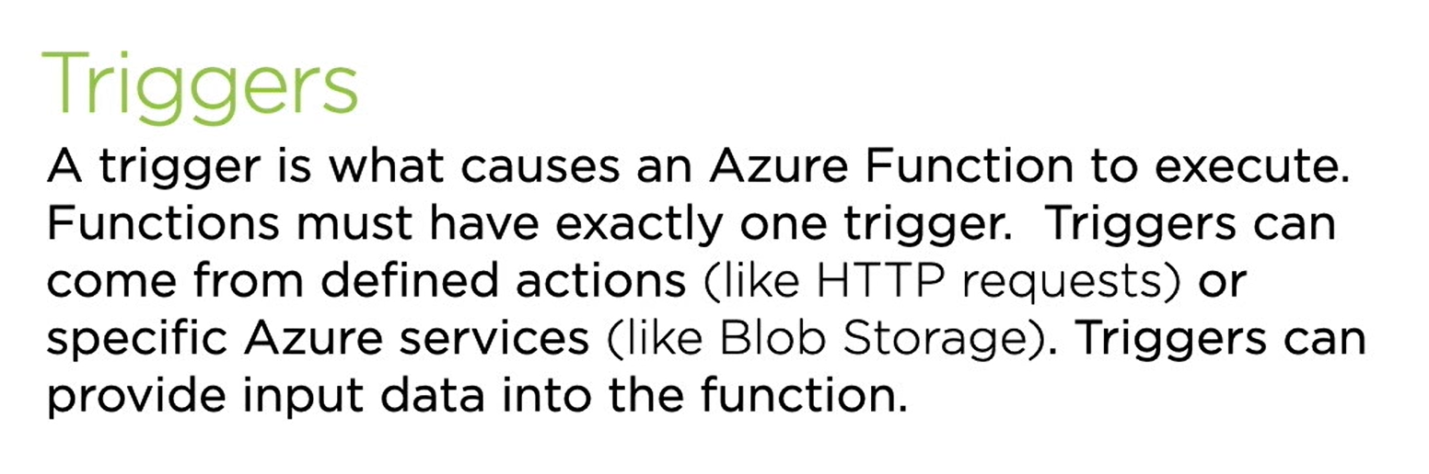

Slide 204
Examples of Function Triggers
HTTP Request
Blob Storage
Cosmos DB
Event Grid
Queue Storage
IoT Hub

Slide 205
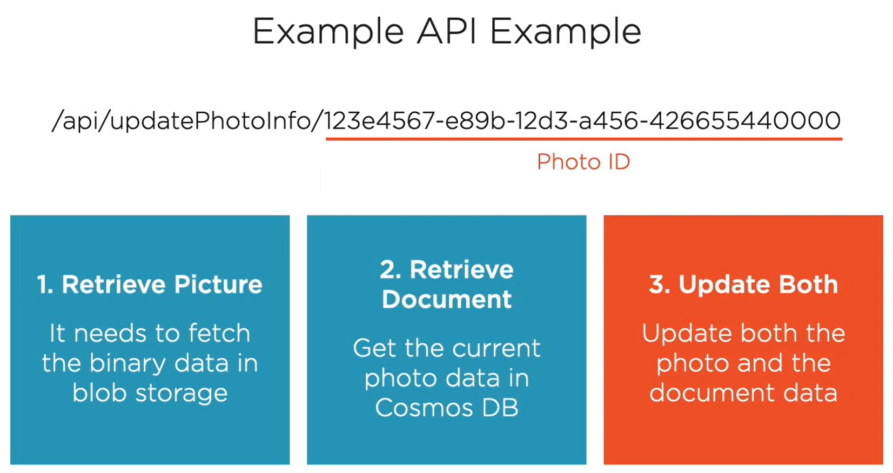

Slide 206
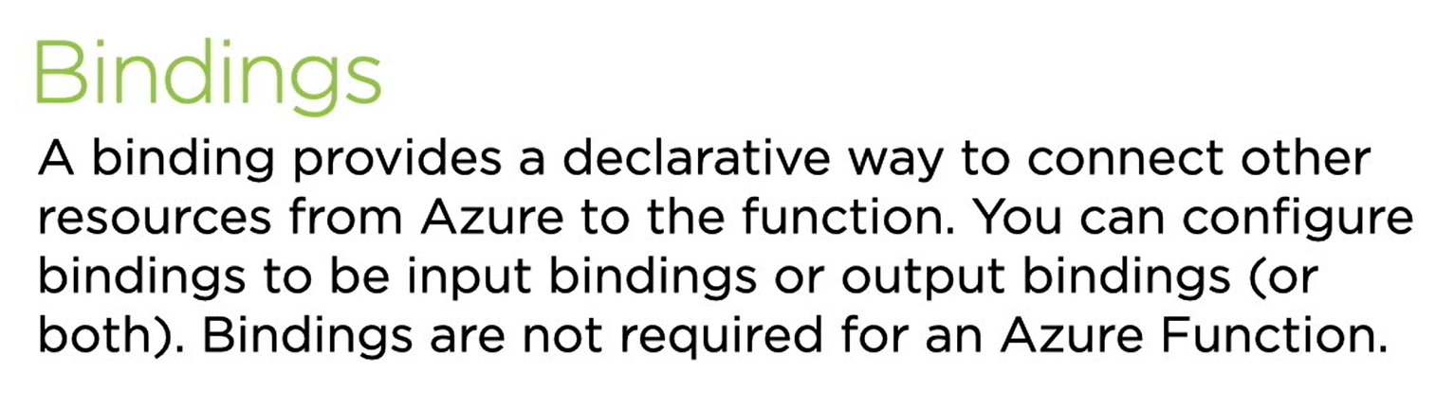

Slide 207
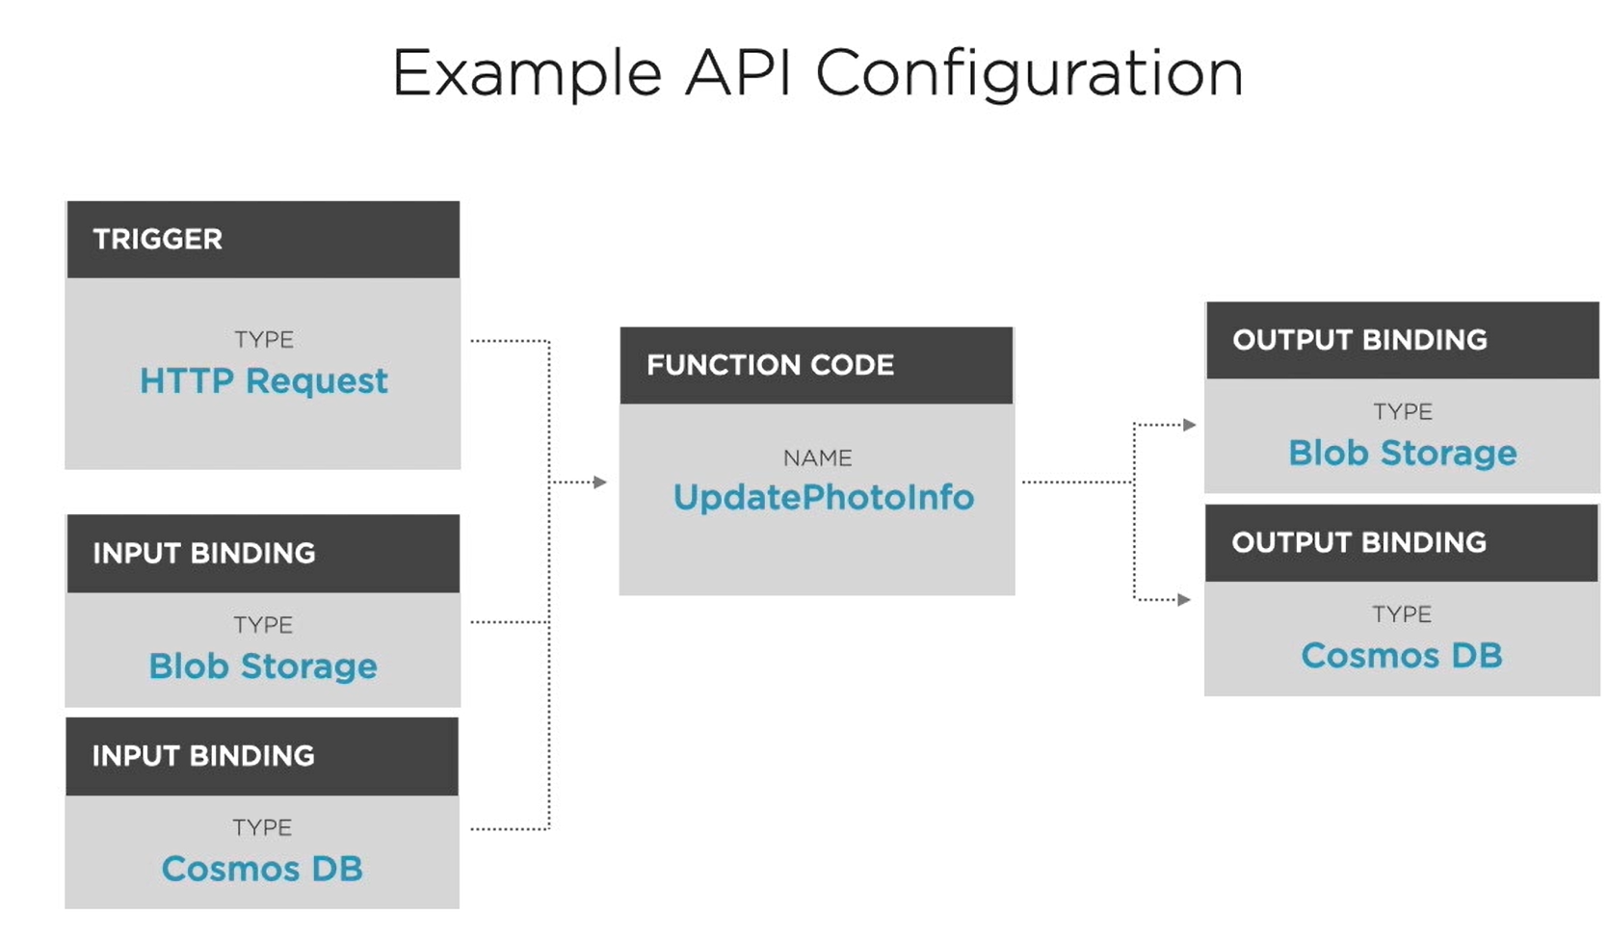

Slide 208
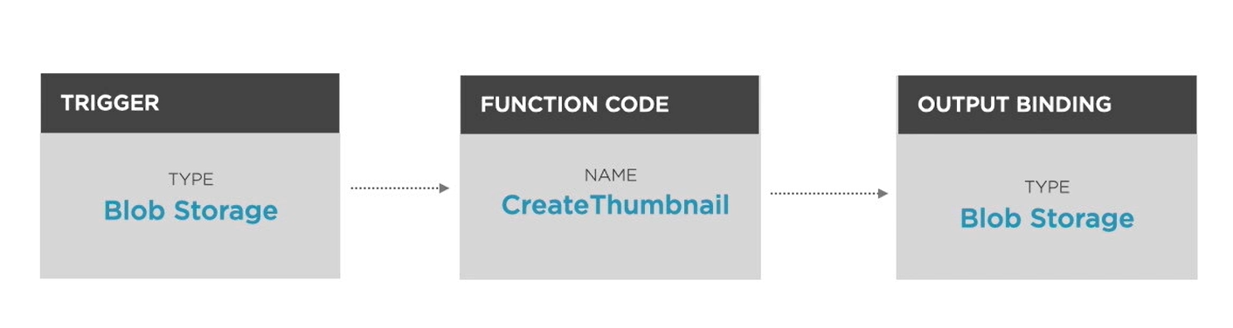
Demo Application

Slide 209
Docker

Slide 210
Docker
Docker is an open platform for developing, shipping, and running applications.
Docker enables you to separate your applications from your infrastructure so you can deliver software quickly.
With Docker, you can manage your infrastructure in the same ways you manage your applications.

Slide 211
What can I use Docker for?
Fast, consistent delivery of your applications
Responsive deployment and scaling
Running more workloads on the same hardware

Slide 212

Docker Architecture

Slide 213
Physical Server||Virtual Machine||Container
CabIt.com (Pune, Blr)
App1
App2
App1
App2
CabIt.com (Mum, Nshk)
Apache, PostgreSQL
Bin / Libs
Bin / Libs
Apache, PostgreSQL
Xubuntu X.x
OS
OS
Xubuntu X.x
PowerEdge 750
Hardware
Hardware
PowerEdge 750
Physical Servers

Slide 214
Physical Server||Virtual Machine||Container
VM-1
VM-2
CabIt.com (Pune, Blr)
App1
App2
App1
App2
CabIt.com (Mum, Nshk)
Apache, PostgreSQL
Bin / Libs
Bin / Libs
Apache, PostgreSQL
Xubuntu X.x
Guest OS
Guest OS
Xubuntu X.x
Hypervisor
OS
PowerEdge 750
Hardware
Virtual Machines

Slide 215
Physical Server||Virtual Machine||Container
VM-1
VM-2
Container - 1
Container - 2
App1
App2
App1
App2
App1
App2
App1
App2
Bin / Libs
Bin / Libs
Bin / Libs
Bin / Libs
Guest OS
Guest OS
Container Runtime
Container Runtime
Hypervisor
Container Engine
OS
OS
Hardware
Hardware
Virtual Machines
Containers

Slide 216
Docker – Behind the scenes
Containers
Images
Volumes
Networks
Client / Docker CLI
CLI / ‘docker’ command
Manages
Rest API
Rest Interface
Docker Daemon
‘dockerd’ command
containerd
OCI Standard
(Open Container Initiative)
runc
Linux Kernel
namespaces
cgroups
Union filesystem

Slide 217

OCI – Open Container Initiative
Source: https://opencontainers.org/

Slide 218
Layer A
Container 1
Image
Layer B
Container 2
Layer C
Container 3

Slide 219
Azure DevOps

Slide 220


Slide 221


Slide 222


Slide 223

Microservices

Slide 224
Monolithic Systems
Coupling is high throughout the codebase
Hidden coupling between subcomponents
Deploying the application is a lengthy process
involve several people and system downtime
The system has a one-size-fits-all architecture
least complex parts of the system will be overengineered

Slide 225
What is a microservice?
A microservice is a service with one, and only one, very narrowly focused capability that a remote API exposes to the rest of the system.

Slide 226
What is capability?
Each little capability in the system is implemented as an individual microservice.
Every microservice in a system
Runs in its own separate process
Can be deployed on its own, independently of the other microservices
Has its own dedicated data store
Collaborates with other microservices to complete its own action

Slide 227
Please Note…
It’s important to note that microservices don’t need to be written in the same programming language (C#, Java, Erlang, and so on)
or
for the same platform (IIS, Node, NGINX, and so on) as ones they collaborate with.
They just need to know how to communicate with each other.
Via a service bus
Via binary protocol like Thrift,
Most common scenario is for microservices to communicate over HTTP.

Slide 228
What is a microservices architecture?
Designing and implementing individual microservices.
Microservices can also be used to describe an architectural style for an entire system consisting of many microservices.
Microservices as an architectural style is a lightweight form of service-oriented architecture.
System with a microservices architecture is a distributed system with a (probably large) number of collaborating microservices.

Slide 229
Microservice characteristics
A microservice is responsible for a single capability.
A microservice is individually deployable.
A microservice consists of one or more processes.
A microservice owns its own data store.
A small team can maintain a handful of microservices.
A microservice is replaceable.

Slide 230
RESPONSIBLE FOR A SINGLE CAPABILITY
SRP – Single Responsibility Principle (OOP)
A microservice has a single responsibility.
That responsibility is for a capability.

Slide 231
Uncle Bob’s way
Uncle Bob states: “Gather together the things that change for the same reasons. Separate those things that change for different reasons.”
This way of stating the principle applies to microservices: a microservice should implement exactly one capability.
That way, the microservice will have to change only when there’s a change to that capability.

Slide 232
Capability Types
A business capability is something the system does that contributes to the purpose of the system, like keeping track of users’ shopping carts or calculating prices.
A technical capability is one that several other microservices need to use, like integration to some third-party system.

Slide 233
INDIVIDUALLY DEPLOYABLE
A microservice should be individually deployable.
When you a change a microservice, you should be able to deploy that changed microservice to the production environment without deploying (or touching) any other part of your system.
Other microservices in the system should continue running and working during the deployment of the changed microservice, and continue running once the new version is deployed

Slide 234

INDIVIDUALLY DEPLOYABLE

Slide 235
CONSISTS OF ONE OR MORE PROCESSES
Each microservice must run in separate processes from other microservices
Each microservice can have more than one process.

Slide 236

Notes:
Consider a Shopping Cart microservice again. If it ran in the same process as a Product Catalog microservice, as shown in figure, the Shopping Cart code might cause
a side effect in the Product Catalog. That would mean a tight, undesirable coupling
between the Shopping Cart microservice and the Product Catalog microservice; one
might cause downtime or bugs in the other.
Now consider deploying a new version of the Shopping Cart microservice. You’d
either have to redeploy the Product Catalog microservice too, or you’d need some
sort of dynamic code-loading capable of switching out the Shopping Cart code in the
running process.

Slide 237
OWNS ITS OWN DATA STORE
A microservice owns the data store where it stores the data it needs.
If each microservice owns its own data store makes it possible to use different database technologies for different microservices depending on the needs of each microservice.

Slide 238

Notes:
One microservice can’t access another’s data store

Slide 239
MAINTAINABLE BY A SMALL TEAM
Maintaining a microservice means dealing with all aspects of
Keeping it healthy and fit for use
Developing new functionality
Factoring out new microservices from ones that have grown
Running it in production
Monitoring, Testing & fixing bugs

Slide 240
REPLACEABLE
The team maintaining the microservice should be able to replace the current implementation with a completely new implementation and do so within the normal pace of their work.
This characteristic is another constraint on the size of a microservice: if a microservice grows too large, it will be expensive to replace; but if it’s kept small, rewriting it is realistic.

Slide 241
Why microservices?
Enable continuous delivery
Allow for an efficient developer workflow because they’re highly maintainable
Are robust by design
Can scale up or down independently of each other

Slide 242
Costs and downsides of microservices
Significant costs are associated with choosing a microservices architecture
Microservice systems are distributed systems
Microservice systems are made up of many microservices
Each microservice is a separate codebase

Slide 243
Questions to ask?
Would this system benefit from the ability to deploy subsystems separately?
Can you build sufficient deployment automation?
Are you sufficiently knowledgeable about the domain to properly identify and separate the system’s various independent business capabilities?
Is the system’s scope large enough to justify the complexity of a distributed architecture?
Is the system’s scope large enough to justify the cost of building the deployment automation?
Will the project survive long enough to recover the up-front investment in automation and distribution?

Slide 244

How Microservice works?

Slide 245
How are microservices connected?
Microservices or modules are decoupled from each other but still able to communicate.
Cross dependencies are typical for a microservice architecture, meaning no single service can perform without getting help from other services.
There are different ways to interconnect microservices, such as:
Brokers (RabbitMQ)
Remote Procedure Calls (RPC)
REST APIS

Slide 246

What is Message Queueing?
The use of Message Queues provides a way for parts of the application to push messages to a queue asynchronously and ensure they are delivered to the correct destination.
To implement message queuing, a message broker like RabbitMQ is a good option.
The message broker provides temporary message storage when the receiving service is busy or disconnected.

Slide 247
Message Broker
A message broker acts as a middleman for the microservices, receiving messages from one application (producers) and handing them over to others (consumers) to do the job.
How Message Broker Works?
In message broker, messages are not published directly to a queue.
Instead, the producer sends a message to an exchange.
The job of an exchange is to accept messages from the producer applications and route them to the correct message queues.
The messages stay in the queue until the consumer handles them and removes them.
RabbitMQ and Apache Kafka are two open-source message brokers

Slide 248
RabbitMQ as the broker
RabbitMQ enables asynchronous processing, meaning that it allows you to put a message in a queue without processing it immediately.
RabbitMQ is therefore ideal for long-running tasks or blocking tasks, allowing web servers to respond quickly to requests instead of being forced to perform computationally intensive tasks on the spot.
RabbitMQ simply stores messages and passes them to consumers when ready.

Slide 249
Features of Rabbit MQ
RabbitMQ is a reliable open-source message broker (Available since 2007)
RabbitMQ supports several standardized protocols such as AMQP, MQTT, STOMP
RabbitMQ is used by many companies within various industries
RabbitMQ is user-friendly
The RabbitMQ broker is scalable and flexible.

Slide 250
What is Kafka?
Kafka is an open-source distributed event streaming platform, facilitating raw throughput.
Written in Java and Scala, Kafka is a pub/sub message bus geared towards streams and high-ingress data replay.
Rather than relying on a message queue, Kafka appends messages to the log and leaves them there, where they remain until the consumer reads it or reaches its retention limit.
Kafka employs a “pull-based” approach, letting users request message batches from specific offsets.
Use Kafka if you need a framework for storing, reading, re-reading, and analyzing streaming data.

Slide 251
Kafka vs RabbitMQ
Kafka vs RabbitMQ | RabbitMQ | Kafka
Performance | 4K-10K messages per second | 1 million messages per second
Message Retention | Acknowledgment based | Policy-based (e.g., 30 days)
Data Type | Transactional | Operational
Consumer Mode | Smart broker/dumb consumer | Dumb broker/smart consumer
Topology | Exchange type: Direct, Fan out, Topic, Header-based | Publish/subscribe based
Payload Size | No constraints | Default 1MB limit
Usage Cases | Simple use cases | Massive data/high throughput cases

Slide 252
Main Capabilities of Kafka
Kafka offers three main capabilities:
A pub-sub mechanism
Storing data (even after consumption is complete) for as long as you want
Process events in batch or real-time (use case specific)
Kafka ensures that any published event can be consumed by multiple consumers, and that those events won’t be deleted or removed from the storage once consumed.
It allows you to consume the same event multiple times, so data durability is top-notch.

Slide 253

Kafka

Slide 254


Slide 255

React to Events Asynchronously

Slide 256


Slide 257
Microservice Collaboration
There are three types of microservice collaboration:
Command-based collaboration, where one microservice uses an HTTP POST or PUT to make another microservice perform an action.
Query-based collaboration, where one microservice uses an HTTP GET to query the state of another microservice
Event-based collaboration, where one microservice exposes an event feed that other microservices can subscribe to by polling the feed for new events
Notes:
Event-based collaboration is more loosely coupled than command- and querybased collaboration.
You can hook into Nancy’s model binding and content negotiation to support data formats other than XML and JSON.
The Nancy bootstrapper is used to configure Nancy itself and Nancy applications.
You can use HttpClient to send commands to other microservices and to query other microservices.
You can use Nancy to expose the endpoints for receiving and handling commands and queries.
Nancy can expose a simple event feed.
You can create a process that subscribes to events by
– Creating a .NET Core console application
– Implementing and installing a console application as a Windows service
– Using a timer to make the console application poll an event feed
– Using HttpClient to read events from an event feed

Slide 258

Collaboration

Slide 259
Event Sourcing
Event Sourcing is a design pattern in which results of business operations are stored as a series of events.
It is an alternative way to persist data.
In contrast with state-oriented persistence that only keeps the latest version of the entity state, Event Sourcing stores each state change as a separate event.
No business data is lost.
Each operation results in the event stored in the database.
This enables extended auditing and diagnostics capabilities

Slide 260
API Gateway
API Gateway is a type of service in a microservices architecture which provides a shared layer and API for clients to communicate with internal services.
The API Gateway can route requests, transform protocols, aggregate data and implement shared logic like authentication and rate-limiters.
You can think about API Gateway as the entry point to our microservices world.
Our system can have one or multiple API Gateways, depending on the clients’ requirements.

Slide 261


API Gateway
Netflix’s Approach

Slide 262
Use cases for API Gateway
Acting as a façade
Routing requests
Dealing with cross-cutting concerns
Authentication and authorization
Log tracing and aggregation
Rate limiting
Load balancing
Translating different protocols

Slide 263
Robustness
Dynamic environments and distributed systems - like microservices - lead to a higher chance of failures.
Services should fail separately, achieve graceful degradation to improve user experience.
70% of the outages are caused by changes, reverting code is not a bad thing.
Fail fast and independently. Teams have no control over their service dependencies.
Architectural patterns and techniques like caching, bulkheads, circuit breakers and rate-limiters help to build reliable microservices.

Slide 264
Cross-Cutting Concerns
Some concerns cut across the entire system. These are the things you need every microservice to do, and they’re often related to keeping the system healthy in production:
Monitoring
Logging errors, requests, performance
Security
Policies related to technologies you use in many microservices—for example, handling database connections

Slide 265
Saga’s
Saga pattern solves the problem of data consistency across different services.
There are two kind of methods that are used in saga pattern. they are,
Orchestration-based Saga
Orchestration based saga is a pattern method where an orchestrator service maintains the communication (command/reply) between services.
So, it helps to mains the data consistency across services.
Choreography-Based Saga
In this method, there is no central orchestrator.
Each service will have a command/reply events. so, for every reply, it will update the database consistently.

Slide 266

Saga in Ecommerce Service

Slide 267
Contact Me
Manish Sharma | Gmail
Manish Sharma | WhatsApp
Manish Sharma | Facebook
Manish Sharma | LinkedIn

